Slide 1
Agenda:
Scientific Research Review (Ch. 2)
Chapter 8: Thought and Language

Slide 2

An Introduction to Psychological Science
Third Canadian Edition
Chapter 2
Reading and Evaluating Scientific Research
Copyright © 2021 Pearson Canada, Inc.
Notes:
If this PowerPoint presentation contains mathematical equations, you may need to check that your computer has the following installed:
1) MathType Plugin
2) Math Player (free versions available)
3) NVDA Reader (free versions available)

Slide 3
2.1 Learning Objectives
Know the key terminology related to principles of scientific research.
Understand the five characteristics of quality scientific research.
Understand how biases might influence the outcome of a study.
Apply the concepts of reliability and validity to examples.
Analyze whether anecdotes, authority figures, and common sense are reliably truthful sources of information.
Notes:
Know the key terminology related to the principles of scientific research.
See bold, italicized terms below.
Understand the five characteristics of quality scientific research.
These characteristics include:
(1) that measurements are objective, valid, and reliable;
(2) the research can be generalized;
(3) it uses techniques that reduce bias;
(4) the findings are made public; and
(5) the results can be replicated.
Understand how biases might influence the outcome of a study.
Demand characteristics affect how participants respond in research studies. Participants might try to guess what the study is about or paint themselves in a favourable light. Researchers can also unintentionally introduce bias.
Apply the concepts of reliability and validity of examples.
Students should be able to read scenarios involving research methods and determine whether there are issues with reliability or validity.
Analyze whether anecdotes, authority figures, and common sense are reliably truthful sources of information.
It is important to critically evaluate the source of information. Is one person telling his/her success story? Such anecdotal evidence is usually not generalizable. Is the claim endorsed by an authority figure or expert? It’s important that it’s not just opinion, but also backed up by data. Common sense is also important, but good scientific research should come first.

Slide 4
Five Characteristics of Quality Scientific Research
Based on measurements that are objective, valid, and reliable
Generalizable
Use of techniques that reduce bias
Made public
Can be replicated
Notes:
1) Quality scientific research meets the following criteria:
i) It is based on measurements that are objective, valid, and reliable.
a) The most important aspect of scientific research is that it strives for objectivity.
b) Objectivity assumes that certain facts about the world can be observed and tested independently from the individual (e.g., scientist) who describes them.
ii) It can be generalized.
iii) It uses techniques that reduce bias.
iv) It is made public.
v) It can be replicated.

Slide 5
Scientific Measurement: Objectivity (1 of 2)
Objective measurements (p. 31)
e.g. weight
Variable (p. 31)
Measuring variables - Examples
Functional magnetic resonance imaging (fMRI)
Blood or saliva
Self-reporting
Notes:
1) The foundation of scientific methodology is the use of objective measurements.
Objective Measurements (p. 31) are the measure of an entity or behaviour that, within an allowed margin of error, is consistent across instruments and observers.
i) For example, weight is something that can be measure objectively.
a) Holding everything constant, a single object should weigh the same using multiple, functioning scales.
ii) The same goes for measuring behaviour in psychology.
a) However, in psychology, the objectivity of the measure often relies on the person doing the measuring.
2) In psychology, we measure variables.
Variable (p. 31) refers to the object, concept, or event being controlled, manipulated, or measured by a scientist.
3) There are a number of instruments used to measure variables.
i) For example, the speedometer in your car measures the variable we call speed.
ii) In psychology, these often take the forms of behavioural measures (no machine to read our minds…yet).
iii) In recent decades, contributions from neuroscience has allowed psychologists to increase the number of variables they can examine.
a) For example, magnetic resonance imaging (MRI) allows researchers to view the brain.
b) Researcher might also gather blood or saliva to be analyzed for enzymes, hormones, and other biological variables that relate to behaviour and mental functioning.
iv) Another common method used by psychologists is self-reporting.

Slide 6
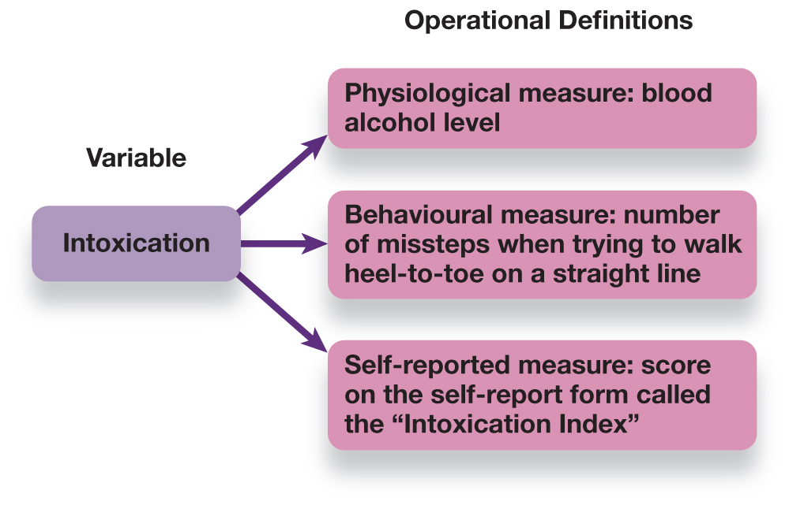
Scientific Measurement: Objectivity (2 of 2)
Figure 2.1 Operational Definitions
A variable, such as the level of intoxication, can be operationally defined in multiple ways. This figure shows operational definitions based on physiology, behaviour, and self-report measures.
Notes:
1) It’s also important that all methods and variables used by researchers are carefully defined.
i) This is important when conducting a study (for replications) as well as when sharing results.
Operational Definitions (p. 32) are statements that describe the procedures (or operations) and specific measures that are used to record observations.
2) Defining variables can be challenging partly because there are often multiple possible operational definitions.
i) For example, intoxication could be reasonably defined physiologically (blood alcohol level), behaviourally (ability to walk in a straight line), or as part of a self-report.
Long Description:
The figure shows intoxication as a variable which can have three operational definitions based on three kinds of measures. The physiological measure of intoxication is the blood alcohol level. The behavioral measure of intoxication includes the number of missteps when trying to walk heel-to-toe on a straight line. The self-reported measure of intoxication includes score on the self-report form called the “Intoxication Index”.

Slide 7
Scientific Measurement: Reliability and Validity
Reliability (p. 32)
Consistent and stable
Validity (p. 32)
True measurements
Notes:
1) The behavioural measures psychologists use must also be reliable and valid.
Reliability (p. 32) is when a measure provides consistent and stable answers across multiple observations and points in time.
2) Multiple psychologists have to be able to observe individuals and record the same behaviour.
i) For example, a group of psychologist might observe children after they watch a violent TV program to see if they display aggressive behaviours.
a) To have high inter-rater reliability, researchers must carefully train the judges as to the operational definitions of what counts as aggression (e.g., specific actions, how long they last, what isn’t aggression, etc.).
ii) In this example, the instruments doing the measuring are people, but the same principles apply to mechanical instruments.
a) Brain scanning machines, scales, etc. must also be reliable and consistent.
3) Closely related to reliability is the concept of validity.
Validity (p. 32) is the degree to which an instrument or procedure actually measures what it claims to measure.
i) For example, a psychologist could claim to measure intelligence based on shoe size.
a) S/He could give a clear operational definition of how to measure shoe size.
b) His/her measure of sure size could be reliable (a tape measure should give the same size every time).
c) However, shoe size is not a valid measure of intelligence.
d) A valid measure would assess things like problem-solving and logical thinking.

Slide 8
Generalizability of Results (1 of 2)
Generalizability (p. 33)
Outside the laboratory
Study large groups
Population (p. 33)
Sample (p. 33)
Notes:
1) It is also important that the results of studies can be applied outside the laboratory to the real world in other contexts, with other people, etc.
Generalizability (p. 33) refers to the degree to which one set of results can be applied to other situations, individuals, or events.
2) Studying a large group of people is one way to increase the likelihood that the results will be generalizable.
i) This way psychologists can report on the average effect for the group and get a better sense of how individuals are likely to behave.
ii) In a perfect world, psychologists would study an entire population of people, however due to time, money, and other costs this is not practical or possible.
a) Instead, researchers study a sample of a population and then generalize the findings from the sample to the population.
Population (p. 33) is the group that researchers want to generalize about.
Sample (p. 33) is a select group of population members

Slide 9
Generalizability of Results (2 of 2)
Best reflection of population
Random sample (p. 33)
Settle for easier sample
Convenience sample (p. 33)
Location of study
Laboratory research
Naturalistic research
Ecological validity (p. 33)
Notes:
1) It is also important that psychologists get a random sample of people from the population so that their sample best reflects the population.
Random Sample (p. 33), every individual of a population has an equal chance of being included.
i) For example, if you wanted to study the population of students at your school, it would most likely be impossible to track them all down, convince them to participate, and then actually have them participate. Therefore, you would take a random sample.
a) If you approached the students you happened to encounter, this wouldn’t be random because you’re more likely to run into students who are in your major, live in your dorm, etc.
b) Instead, you could have a computer randomly select names of students.
c) However, obtaining a truly random sample is very difficult and so psychologists are more likely to settle for convenience samples (e.g., Intro Psych students).
Convenience Samples (p. 33) are samples of individuals who are the most readily available.
2) The location of the study can also affect the generalizability of the findings.
i) There are two primary research locations.
a) Laboratory research includes any study conducted in an environment controlled by the researcher.
b) Naturalistic research takes place where the behaviour would typically occur.
3) Although laboratory research is convenient because researchers have complete control over the environment, it can limit generalizability because the laboratory does not always reflect the real world.
i) For example, the effects of a cognitive improvement CD were studied by bringing volunteers into the laboratory and measuring their ability to problem solve, might not generalize to a classroom where students are taking real tests for real grades.
Ecological Validity (p. 33) is the degree to which the results of a laboratory study can be applied to or repeated in the natural environment.

Slide 10
Sources of Bias in Psychological Research
Researcher Bias
Subject/Participant Bias
Hawthorne effect (p. 35)
Social Desirability (p. 35)
Notes:
1) In order to have sound research, it is also important to keep bias out of the research.
i) Various types of bias can be introduced by the researchers (researcher bias) doing the measuring as well as by the people or animals being observed (subject/participant bias).
Hawthorne Effect (p. 35) is a term used to describe situations in which behaviour changes as a result of being observed.
2) In the 1920s, a study was done to examine the relation between productivity and working conditions at Western Electric Company’s Hawthorne Works.
i) Researchers found that changing the lighting increased productivity.
ii) They also found giving fewer, but longer breaks increased productivity.
iii) In fact, any change the researchers made resulted in productivity increases.
a) This is because after each change, the factory supervisors paid close attention to the workers.
b) In this case, the research results were biased by the expectations of those observing as well as those being observed.
3) When participants are aware that they are being observed (and they usually are), they may adjust their behaviour in anticipation of how others may respond.
Social Desirability/Socially Desirable Responding (p. 35) means that research participants respond in ways that increase the chances that they will be viewed favourably by the experimenter and/or other participants.
i) For example, many participants will not openly admit to being biased toward a certain social group (e.g., race, religion, sexual orientation) because that is not acceptable in our society.

Slide 11
Working the Scientific Literacy Model: Demand Characteristics and Participant Behaviour (1 of 2)
What do we know about how bias affects research participants?
Demand characteristics (p. 36)
How can science test the effects of demand characteristics on behaviour?
Backpack scenario
Notes:
1) What do we know about how bias affects research participants?
i) Participants actively participate in studies and will often try to guess what the study is about. Instead of answering questions honestly, participants will sometimes answer in a way that makes them look good.
Demand Characteristics (p. 36) are inadvertent cues given off by the experimenter or the experimental context that provide information about how participants are expected to behave.
a) For example, a researcher asks a volunteer to wear a heavy backpack and then asks him/her to guess how steep a ramp is.
2) How can science test the effects of demand characteristics on behaviour?
i) Using the same backpack scenario, a study was done to examine how demand characteristics affect people’s judgment.
ii) Participants were placed into 1 of 3 groups.
a) One group was simply asked to judge the steepness of the ramp.
b) One group was asked to wear a 25-pound backpack and judge the steepness of the ramp.
c) The third group was given a 25-pound backpack and told it was full of electrical equipment to measure muscle activity in their ankles. To increase believability, they attached electrodes to the participants ankles.
iii) The participants were then asked to judge the steepness of the ramp.
a) All participants were taken to a room with the same ramp and asked how steep they thought it was before and after stepping on it.
b) After this, participants sat at a computer and answered a survey including questions in which they guessed the purpose of the study.
c) Students who wore the backpack with no explanation, judged the ramp to be steeper before and after stepping on it compared to the other two groups.
d) This same group also guessed the study was about the effects of wearing a heavy backpack on perceptions of steepness (the other two groups did not guess this).

Slide 12
Working the Scientific Literacy Model: Demand Characteristics and Participant Behaviour (2 of 2)
How can we critically evaluate the issue of bias in research?
Researcher bias
Bright rats vs. dull rats
Why is this relevant?
Bias compromises studies
Placebo effect (p. 35)
Notes:
1) How can we critically evaluate the issue of bias in research?
i) Researchers are another source of bias in research.
ii) For example, Rosenthal and colleagues conducted a study in which they told teachers in 18 different classrooms that a certain group of children had “unusual” potential for learning (when in reality they were just a random selection of students).
a) After 8 months, the children singled out as promising showed significant gains in grades and intelligence test scores (which are believed to be relatively stable).
iii) Similar results have also been found with animal research.
a) When research assistants were told they were handling “bright” rats, it appeared the animals learned faster than when handling “dull” rats.
b) Given the rats were not influenced by these terms, it is likely the assistants made subtle changes in how they observed and recorded behaviour.
2) Why is this relevant?
i) Demand characteristics and other sources of bias can compromise research studies, so researchers must be vigilant to eliminate or control for such factors.
Placebo Effect (p. 35) is a measurable and experienced improvement in health or behaviour that cannot be attributable to a medication or treatment.
ii) To control for such an effect in drug (or other medical, surgical, etc.) treatments, researchers often have a placebo group.
a) In other words, one group gets the real pill and another group gets a sugar pill (and no one is told who has which pill).
b) Those in the placebo group, who took the sugar pill, report feeling better.

Slide 13
Psych @ The Hospital: The Placebo Effect
Debate about placebo effect
“All in their head”
Actual physiological response
Brain activity in regions involved in pain
Multiple ways for placebos to affect our responses to pain
Notes:
1) The reason people feel better after taking a placebo is up for debate.
i) Some argue the effect is “all in their head,” whereas some believe there is an actual physiological response that leads to improvement, and others say both.
ii) Those given a placebo have shown physiological evidence of pain and nausea relief.
iii) Mayberg and colleagues (2002) found that people responding to placebos showed increased activity in several regions of the frontal lobes. Some participants may create a new “mental set” of their current state, creating the belief that their pain was going to decrease. A decrease was also noted in activity in a number of other brain regions that might represent changes in the sensitivity of pain pathways. These results suggest that there are multiple ways for placebos to affect our responses to pain.

Slide 14
Techniques That Reduce Bias
Anonymity
Confidentiality
Inform participants
Single-blind study (p. 37)
Double-blind study (p. 37)
Notes:
1) The best technique to reduce subject bias is to provide anonymity and confidentiality to volunteers.
i) Anonymity means that each individual’s responses are recorded without any name or other personal information that could link a particular individual to specific results.
ii) Confidentiality means that the results will be seen only by the researcher.
2) Also informing participants about how the data will be used can help reduce their anxiety in participating.
i) They are less likely to be concerned with their performance if they know their data is not going to be used to diagnose psychiatric problems, affect their grades, or harm them.
3) Participant bias can also be reduced by using blind procedures.
Single-Blind Study (p. 37), the participants do not know the true purpose of the study, or else do not know which type of treatment they are receiving (for example, a placebo or a drug).
4) Researchers can also introduce bias, so an even more effective technique is a double-blind study.
Double-Blind Study (p. 37) is a study in which neither the participant nor the experimenter knows the exact treatment for any individual.
i.) In this case, the researcher has an assistant conduct the observations, or at the very least, the researcher is not told which volunteer got what treatment.
5) Double-blind procedures are the best techniques for removing researcher and participant bias.
i) Even the most ethical researcher might be influenced if s/he stands to make money from a test.
ii) As we’ve seen, the Hawthorne Effect can also influence participants’ performance.

Slide 15
Sharing the Results
Academic journals
Peer review (p. 37)
Replication (p. 38)
Notes:
1) One of the most important aspects of scientific research is making the results public.
i) Sharing results is what allows researchers to test hypotheses and build theories.
2) Academic journals are the primary method of sharing results in psychology.
i) These are softbound books that contain a number of articles by different researchers on a single topic.
3) However, before research findings are published in academic journals, they go through a peer review process, which consists of two main tasks.
Peer Review (p. 37) is a process in which papers submitted for publication in scholarly journals are read and critiqued by experts in the specific field of study.
i) First, an editor receives the manuscript from the researcher and determines whether it fits in with the topics covered by that journal.
a) For example, an article on 17th century Italian sculpture wouldn’t belong in the Journal of Cognitive Neuroscience).
ii) Next, the editor sends copies of the manuscript to a select group of peer reviewers.
a) Peers in this case means other professionals working in the same field of study.
b) These reviewers critique the methods and results of the research and make recommendations to the editor regarding the merits of the research.
iii) This process helps to ensure that only the best research is made public.
4) Once results are public, the studies can be replicated.
Replication (p. 38) is the process of repeating a study and finding a similar outcome each time.
i) The same outcome should be found as long as objective measures and techniques are used and if the original hypothesis was correct.
a) However, not all results are replicated.
5) Earlier, the Mozart effect was discussed. This is the idea that listening to classical music makes you smarter. One of the first studies claiming this was in 1993.
i) Skeptical researchers tried to replicate the results without much luck.
a) Failure to replicate may indicate unintentional researcher bias, or sampling bias, or just fluke results.

Slide 16
Five Characteristics of Poor Research (1 of 2)
Lack of falsifiable hypotheses (p. 38)
Testability requires falsifiability
Anecdotal evidence (p. 38)
weight loss commercials
Biased selection of data
Notes:
1) There are a lot of scientific-sounding claims being made on TV, the internet, etc. It is important to know how to differentiate between weak and strong research. Poor research comes most often in one of five varieties: unfalsifiable hypotheses, anecdotes, biased selection of data, appeals to authority, and appeals to common sense.
2) For a research hypothesis to be testable, it must be falsifiable. Developing a testable hypothesis can sometimes be very challenging but if you can’t possibly disconfirm a hypothesis, then there is no point in testing it.
Falsifiable (p. 38) means that the hypothesis is precise enough that it could be proven false.
3) Anecdotal evidence is another sign of poor research. For example, you might have seen a weight loss commercial with a person who lost 200 pounds.
Anecdotal Evidence (p. 38) is an individual’s story or testimony about an observation or event that is used to make a claim as evidence.
ii) There is no way of knowing if this evidence is true.
a) The result of the weight loss could have been due to a thyroid problem that was fixed or changes in physical activity that were not a part of the diet plan.
4) Even if a scientific claim is backed up by published data, some individuals may present only the data that supports their views.
i) The vast majority of scientific studies on climate change support the idea that human behaviour is the cause. An unscrupulous politician, though, may cite only the few studies that cast doubt on that.

Slide 17
Five Characteristics of Poor Research (2 of 2)
Appeal to authority (p. 39)
Corresponding data?
Biased expert?
Appeal to common sense (p. 39)
Earth is centre of universe
Notes:
5) Appeals to authority are another kind of questionable evidence.
Appeal to Authority (p. 39) is the belief in an “expert’s” claim even when no supporting data or scientific evidence is present.
i) It is important to note that an expertise in an area or topic does not mean evidence.
a.) The expert could be mistaken, dishonest, overpaid, or misquoted.
ii) One should also check to see if there is corresponding data to support the claim.
iii) It is also important to consider whether the expert has something to gain or a hidden agenda.
6) The final kind of poor evidence is the appeal to common sense.
Appeal to Common Sense (p. 39) is the claim that appears to be sound, but lacks supporting scientific evidence.
i) For example, many people throughout history assumed the world was the stationary centre of the universe. The idea that the Earth could orbit the sun at blinding speeds
was deemed nonsense because surely such a force would fling us all into space.
a) Appeals to tradition and appeals to novelty can also lead to mistaken beliefs.

Slide 18
2.2 Learning Objectives
Know the key terminology related to research designs.
Understand what it means when variables are positively or negatively correlated.
Understand how experiments help demonstrate cause-and-effect relationships.
Apply the terms and concepts of experimental methods to research examples.
Analyze the pros and cons of descriptive, correlational, and experimental research designs.
Notes:
Know the key terminology related to research designs.
See bold, italicized terms below.
Understand what it means when variables are positively or negatively correlated.
When two variables are positively correlated, they happen together (increase or decrease). For example, income and education or positively correlated. When two variables are negatively correlated, as one increases, the other decreases. For example, more sleep is associated with less irritability.
Understand how experiments help demonstrate cause-and-effect relationships.
Experiments rely on random assignment and the manipulation of an independent variable to show cause and effect. Two or more groups are randomly assigned to a group to ensure the groups are roughly equal. Then researchers manipulate an independent variable and measure the dependent variable. If one group turns out to be different, that difference is most likely due to the independent variable.
Apply the terms and concepts of experimental methods to research examples.
Students should be able to read research scenarios and identify which experimental methods are being used.
Analyze the pros and cons of descriptive, correlational, and experimental research designs.
Descriptive methods allow researchers to observe and give rich details about naturally occurring behaviours. Correlational designs build on this design by showing how those observed variables relate. However, correlation does not equal causation. Experiments are needed to determine cause-and-effect relations. However, experiments done in laboratories may lack generalizability to real-world situations.

Slide 19
Descriptive Research (1 of 2)
Descriptive data
From observations
No attempt to explain why
Qualitative Research (p. 42)
Notes:
1) The beginning of any new line of research must involve descriptive data.
i) This type of data is only from observations.
ii) There is no attempt to explain why a behaviour happened.
iii) For example, researchers might observe a two-year-old and count how many words are spoken or see how many hours per week a typical college student spends on homework.
Qualitative research (p. 42) involvers examining an issue or behaviour without performing numerical measurements of the variables.
2) To gather descriptive data, psychologists use case studies, naturalistic observation, or surveys and questionnaires.

Slide 20
Descriptive Research (2 of 2)
Case study (p. 42)
Extensive details
Lacks generalizability
Naturalistic observation (p. 44)
Self-reporting (p. 45)
Participant makes the observations
Notes:
1) Case studies are useful when a researcher can assess very specific details about an individual, such as symptoms of psychological disorders and detailed descriptions of successes or failures in treatment.
Case Study (p. 43) is an in-depth report about the details of a specific case.
i) This design allows researchers to gain extensive details regarding the effects of a treatment on an individual.
ii) For example, one study followed an individual for 16 weeks to examine a specific type of anxiety disorder.
iii) Researchers documented how and when changes happened, and the effects of the treatment on the individual and the individual’s life.
iv) The main disadvantage of this design is that there is no guarantee the findings can be generalized to other individuals and situations.
2) Another approach is to observe people and animals in their natural settings.
Naturalistic Observation (p. 44) is when psychologists unobtrusively observe and record behaviour as it occurs in the subject’s natural environment.
i) Naturalistic observation can happen anywhere that behaviour occurs.
ii) For example, researchers might observe chimpanzees in forests or even human behaviours after drinking at a bar.
iii) The key is that the researchers are making systematic observations of specific variables according to operational definitions.
a) This is in contrast to those of us who like to people-watch.
iv) However, when researchers want more specific types of data, sometimes they need to develop specific questions for participants to answer.
3) Surveys and questionnaires are still a method of observation, except now the participant is making the observation regarding his/her beliefs, attitudes, opinions, etc.
Self-Reporting (p. 45) is a method in which responses are provided directly by the people who are being studied, typically through face-to-face interviews, phone surveys, paper and pencil tests, and web-based questionnaires.
i) Self-reports usually take the form of surveys that include scales measuring attitudes, opinions, beliefs, and abilities.
ii) Respondents rate their agreement with a set of statements on a scale (e.g., 1 to 7).
iii) Self-reports also include achievement and intelligence tests designed to measure cognitive abilities.

Slide 21
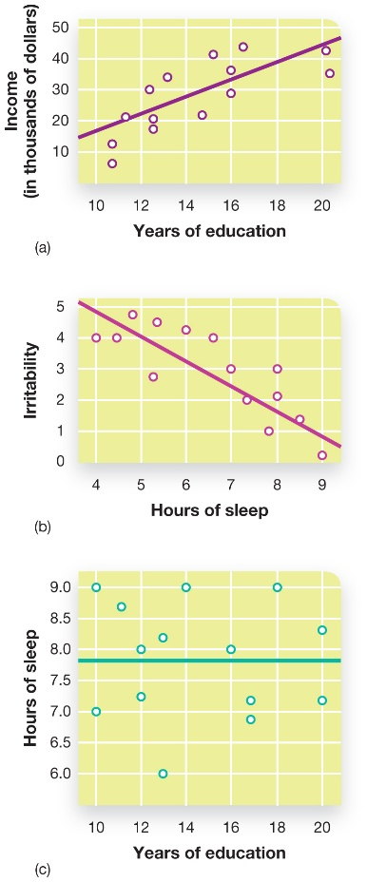
Correlational Research
Figure 2.4 Correlations Are Depicted in Scatterplots
Here we see two variables that are positively correlated (a) and negatively correlated (b). In the example of a zero correlation (c), there is no relationship between the two variables.
Notes:
1) Psychologists almost always observe more than one behaviour or variable in descriptive research and they often want to know how these variables relate.
Correlational Research (p. 45) involves measuring the degree of association between two or more variables.
2) Correlational research may involve any of the descriptive methods discussed earlier, but now the data are evaluated in such a way to see if there are relationships between the variables.
i) For example, do countries with higher graduation rates also tend to have higher income levels?
a) How the variables relate or correlate can be visualized by using scatter plots.
3) Correlations have two main characteristics.
i) They have a direction (Figure 2.4).
a) They can be positive, meaning they both variables occur together (e.g., as one increases, so does the other).
b) They can be negative, meaning that more of one variable, the less of the other (e.g., more sleep, less irritability).
ii) Correlations also have magnitude or strength.
a) This magnitude (like direction) is described in terms of a measure called the correlation coefficient.
b) The correlation coefficient ranges from -1.0 to +1.0, but the closer to the absolute of 1.0, the stronger the relation.
c) In a scatterplot, the dots are very close together when there is a strong correlation and all over the place when there is a weak correlation.
4.) It is important to keep in mind that correlations only show how variables are related. A correlation does not equal causation!
i.) For example a sense of good humour is related to positive health.
a.) Does humour cause one to have good health?
b.) Does good health lead of a good humour?
c.) Or maybe a third variable causes both good humour and health.
iii.) We cannot establish cause with correlations because of the third variable problem.
Third Variable Problem (p. 46) refers to the possibility that a third, unmeasured variable is actually responsible for a well-established correlation between the two variables.
Long Description:
The three figures are as follows:
The first graph shows a positive correlation between the income and the years of education. The x-axis shows the years of education from 10 to 20 in increments of 2. The y-axis shows the income in thousands of dollars from 10 to 50 in increments of 10. The curve starts from 15,000 dollars for less than 10 years of education and increases to about 45,000 dollars for 20 years of education.
The second graph shows a negative correlation between irritability and hours of sleep. The x-axis shows the hours of sleep from 4 to 9 in increments of 1. The y-axis shows irritability from 0 to 4 in increments of 1. The graph shows that at less than four hours of sleep, the irritability is 5 which drops to 0 for over 9 hours of sleep.
The third graph shows a zero correlation between hours of sleep and years of education. The x-axis shows the years of education from 10 to 20 in increments of 2. The y-axis shows the hours of sleep from 6 to 9 in increments of 0.5. The graph shows a horizontal line at 7.9 hours of sleep.

Slide 22
Myths in Mind: Beware of Illusory Correlations
Illusory correlations (p. 47)
Crime increases when the moon is full
Opposites attract
Gamblers on a “hot streak”
Stereotypes
Notes:
1) Many common beliefs ingrained in our culture consist of perceived correlations that actually do not exist.
Illusory Correlations (p. 47) are relationships that really exist only in the mind, rather than in reality.
i) For example, crime increases when there is a full moon, opposites attract, and that gamblers can get on a “hot streak”.
a) Sound research studies have failed to show that full moons are related to bizarre or violent behaviour.
b) People who are attracted to each other are usually very similar.
c) And there is no such thing as a hot streak in competitive sports or gambling.
ii) Stereotypes are often based on illusory correlations.
2) However, these perceptions of correlations exist because they easily come to mind.
i) Normal events don’t stand out as much, so we are less likely to take note of them, and, in turn, are slower to recall them vs. events or pairings that are not normal.

Slide 23
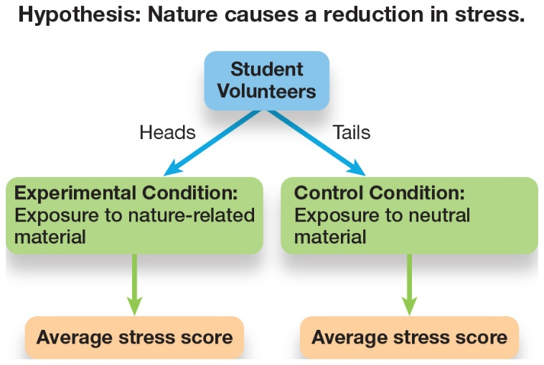
Experimental Research: The Experimental Method
Figure 2.5 Elements of an Experiment
If we wanted to test whether exposure to nature-related images causes a reduction in stress (as is assumed by people who have nature scenes as their computer’s wallpaper), we would first need to randomly assign people in our sample to either the experimental or control condition. The dependent variable, the stress levels, would be measured following exposure to either nature-related or neutral material. To test whether the hypothesis is true, the average stress scores in both groups would be compared.
Notes:
1) Experimental designs are the only designs that can provide strong evidence for cause-and-effect relationships.
2) Like correlational research, experiments have at least two variables. However, there are two main differences between the two designs.
i) The random assignment of participants.
ii) The experimenter’s control over the variables being studied.
Random Assignment (p. 48) is a technique for dividing samples into two or more groups in which participants are equally likely to be placed in any condition of the experiment.
3) Random assignment gives each participant an equal chance of being place into any one of the experimental groups.
i) This helps to ensure that the groups are roughly equal.
ii) Allowing the participants to pick the group might lead to unequal groups.
a) After all, there are individual reasons why we might choose to group ourselves with others.
4) When groups are not randomly assigned, all sorts of confounding variables could enter the picture.
Confounding variables (p. 48) are variables outside of the researcher’s control that might affect or provide an alternative explanation for the results.
i) Confounding variables differ depending on the variables and design of the study.
ii) However, researchers typically cannot control the moods participants are in or an individual’s personality.
5) There are also specific types of variables used in experiments: dependent and independent variables.
Independent Variable (p. 48) is the variable that the experimenter manipulates to distinguish between two or more groups.
Dependent Variable (p. 48) is the observation or measurement that is recorded during the experiment and subsequently compared across all groups.
i) With regard to our experiment on how humourous material affects stress, exposure to humourous material or non-humourous material would be the IV and one’s stress score would be the DV.
a) The experimental group would view the humourous material and the control group would view the non-humourous material.
Experimental Group (p. 48) is the group in the experiment that receives a treatment or the stimuli targeting a specific behaviour.
Control Group (p. 48) is the group that does not receive the treatment or stimuli targeting a specific behaviour; this group therefore serves as a baseline to which the experimental group is compared.
b) If the experimental group showed a reduction in stress, we could conclude that exposure to humourous materials is responsible for the difference (as long as it was a well-designed experiment and confounds were accounted for).
ii) The example described above would be a between-subjects design.
Between-Subjects Design (p. 48) is an experimental design in which we compare the performance of participants who are in different groups.
a.) Those two groups might be different from each other simply by chance making it difficult to detect differences caused by the IV. In order to reduce this possibility, researchers often use a within-subjects design.
Within-Subjects Design (p. 48) is an experimental design in which the same participants respond to all types of stimuli or experience all experimental conditions.
Long Description:
The hypothesis shown is Nature causes a reduction in stress.
If the hypothesis that the nature causes a reduction in stress needs to be tested, student volunteers will be recruited. The student volunteers will be divided into two groups. Half of the students will be exposed to experimental conditions while the remaining half will be exposed to neutral material. Then finally the average stress score of each group will be taken.

Slide 24
Experimental Research: The Quasi-Experimental Method
Quasi-experimental research (p. 49)
Random assignment not always possible
Comparing men and women
Cannot determine cause-and-effect
Notes:
1) Random assignment and manipulation of a variable are needed to determine cause and effect relationships. However, in some cases, random assignment is not possible.
Quasi-Experimental Research (p. 49) is a research technique in which the two or more groups that are compared are selected based on predetermined characteristics, rather than random assignment.
2) For example, many studies compare men and women.
i) We can’t randomly assign people to one group or the other.
ii) Men and women are also bound to differ in terms of genetics, gender roles, family history, and so on.
iii) Because of this, quasi-experiments can point out relationships, but cannot determine what causes the differences between groups (like correlations).

Slide 25
2.4 Learning Objectives
Know the key terminology of statistics.
Understand how and why psychologists use significance tests.
Apply your knowledge to interpret the most frequently used types of graphs.
Analyze the choice of central tendency statistics based on the shape of the distribution.
Notes:
Know the key terminology of statistics.
See bold, italicized terms below.
Understand how and why psychologists use significance tests.
Significance tests are statistics that tell us whether differences between groups are meaningful. For example, the mean scores of two groups could be very different; however, the variability of scores within each group will determine the likelihood the means of the two groups significantly differ.
Apply your knowledge to interpret the most frequently used types of graphs.
Students should be able to look at a histogram and be able to answer questions regarding its shape, measures of central tendency, and frequency of scores.
Analyze the choice of central tendency statistics based on the shape of the distribution.
It is important to consider they type of data and the shape of the distribution. For example, the mean and median usually give us more information about the central tendency. The mode is usually used for categorical data. For example, a mode can represent a candidate with the most votes.
Analyze the conclusions that psychologists can reach based on significance tests.
If the means between two groups are found to be significant, we can conclude the difference is farther apart than would be expected by random chance alone. In other words, the two groups are from two separate populations and/or the IV had an effect.

Slide 26
Descriptive Statistics
Descriptive statistics (p. 60)
Frequency
Central tendency
Variability
Notes:
1) Once the data has been collected, the next step is data analyses.
i) Initially, this involves organizing numbers into ways that can be summarized and visualized to get an overall picture of trends and possible outcomes of the research.
ii) Data analysis is also important in confirming or rejecting a hypothesis.
Descriptive Statistics
1) The first step in getting an overall picture of the data, is describing the data.
Descriptive Statistics (p. 60) are a set of techniques used to organize, summarize, and interpret data.
i) The most commonly used descriptive statistics are: frequency, central tendency, and variability.

Slide 27
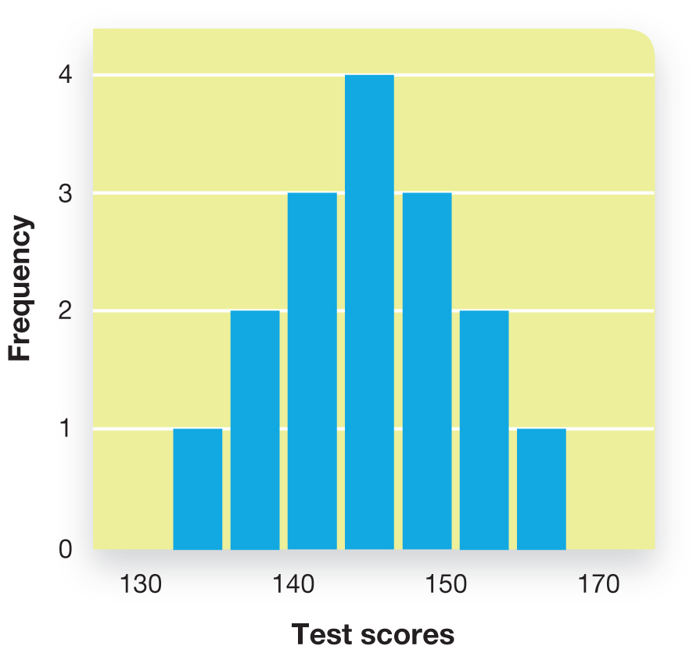
Frequency (1 of 2)
Figure 2.7 Graphing Psychological Data
The frequency of standardized test scores forming a normal curve.
Notes:
1) Graphing the data is a logical first step in getting an overall picture of how the data looks.
i) This allows researchers to see the distribution, or the location of where the scores cluster on a number line and to what degree they are spread out.
2) Psychologists often graph data using a type of bar graph called a histogram.
i) Like most bar graphs, the vertical axis shows the frequency.
Frequency (p. 60) is the number of observations that fall within a certain category of range of scores.
ii) These graphs are easily interpreted; the higher the bar, the more scores that fall into that specific range.
iii) The horizontal axis basically describes the heights of the bars.
3) Graphing gives a visual image from which psychologists can describe the data and make general estimates.
i) For example, it shows where scores cluster together and how spread out they are.
4) When scores are clustered in the middle and the right side of the curve mirrors the left side, we can describe this as symmetrical curve.
Normal Distribution (p. 60) (also called a bell curve) is a symmetrical distribution with values clustered around a central, mean value.
i) Many variables fall into a normal distribution, such as the scores on most standardized tests.
5) Sometimes the data clusters at one end and trails off at the other. In this case, we have a skewed distribution.
Negatively Skewed Distribution (p. 60) occurs when the curve has an extended tail to the left of the cluster.
Positively Skewed Distribution (p. 60) occurs when the long tail is on the right of the cluster.
i) Most of the time, skews occur because there is an upper or lower limit to the data.
a) For example, a person cannot take less than 0 minutes to complete a test.
b) Instead, most students might finish a quiz in 6 minutes, but a few took much longer.
c) Conversely, most scores would cluster around 90% on an easy quiz with a couple tailing off into the lower grades.
Long Description:
The details of the graph are as follows:
The x-axis shows the test scores. The y-axis shows the frequency from 0 to 4 in increments of 1. The graph shows the following data:
130: 1
135: 2
140: 3
145: 4
150: 3
155: 2
160: 1

Slide 28
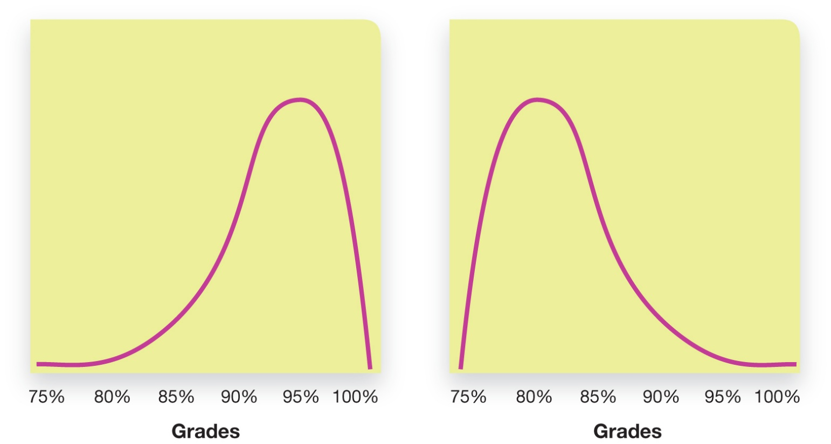
Frequency (2 of 2)
Figure 2.8 Skewed Distributions
Negatively skewed distributions have an extended tail to the left (as in the left graph below). Positively skewed distributions have an extended tail to the right (as in the right graph below).
Notes:
1) Graphing the data is a logical first step in getting an overall picture of how the data looks.
i) This allows researchers to see the distribution, or the location of where the scores cluster on a number line and to what degree they are spread out.
2) Psychologists often graph data using a type of bar graph called a histogram.
i) Like most bar graphs, the vertical axis shows the frequency.
Frequency (p. 60) is the number of observations that fall within a certain category of range of scores.
ii) These graphs are easily interpreted; the higher the bar, the more scores that fall into that specific range.
iii) The horizontal axis basically describes the heights of the bars.
3) Graphing gives a visual image from which psychologists can describe the data and make general estimates.
i) For example, it shows where scores cluster together and how spread out they are.
4) When scores are clustered in the middle and the right side of the curve mirrors the left side, we can describe this as symmetrical curve.
Normal Distribution (p. 60) (also called a bell curve) is a symmetrical distribution with values clustered around a central, mean value.
i) Many variables fall into a normal distribution, such as the scores on most standardized tests.
5) Sometimes the data clusters at one end and trails off at the other. In this case, we have a skewed distribution.
Negatively Skewed Distribution (p. 60) occurs when the curve has an extended tail to the left of the cluster.
Positively Skewed Distribution (p. 60) occurs when the long tail is on the right of the cluster.
i) Most of the time, skews occur because there is an upper or lower limit to the data.
a) For example, a person cannot take less than 0 minutes to complete a test.
b) Instead, most students might finish a quiz in 6 minutes, but a few took much longer.
c) Conversely, most scores would cluster around 90% on an easy quiz with a couple tailing off into the lower grades.
Long Description:
The two graphs are shown with grades on the x-axis. The graph on the left shows a negative skewed distribution which has an extended tail to the left. The graph on the right shows a positive skewed distribution with an extended tail to the right.

Slide 29
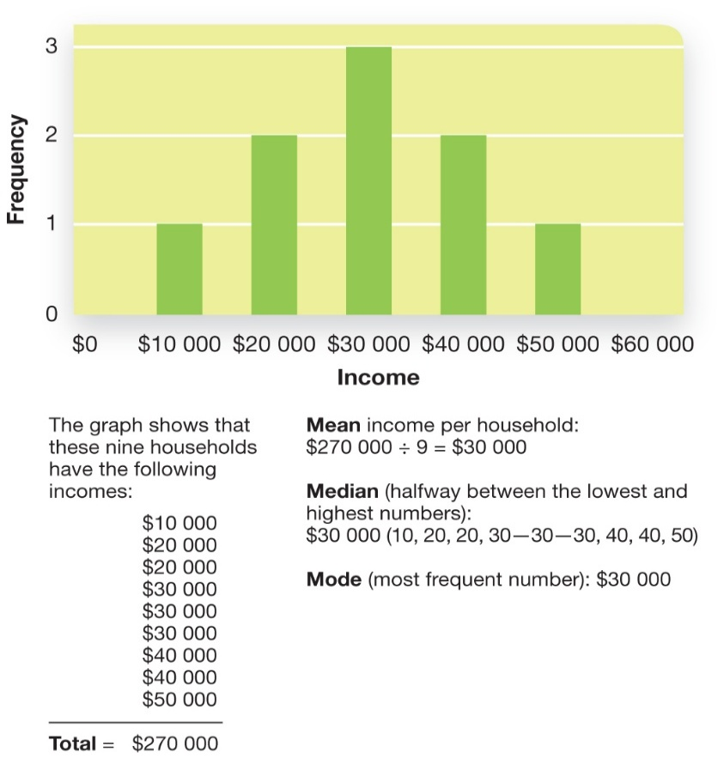
Central Tendency
Figure 2.9 Central Tendency in Symmetrical Distributions
This symmetrical histogram shows the annual income of nine randomly sampled households. Notice that the mean, median, and mode are all in the same spot—this is a characteristic of normal distributions.
Notes:
1) When we identify the portion of the graph where the scores seem to cluster together, we are estimating central tendency.
Central Tendency (p. 60) is a measure of the central point of a distribution.
i) This is a single number that represents an entire data set.
ii) The measure of central tendency we use can depend on the distribution of data.
2) Psychologists use one of three measures to describe the central tendency of the data: mean, median, and mode.
Mean (p. 60) is the arithmetic average of a set of numbers.
Median (p. 60) is the 50th percentile—the point on the horizontal axis at which 50% of the observations are lower and 50% of all observations are higher.
Mode (p. 60) is the category with the highest frequency (i.e. the category with the most observations).
i) However, the mean and median usually give us more information about the central tendency (where scores cluster).
ii) The mode is usually used for categorical data.
a) For example, a mode can represent a candidate with the most votes.
3) In a histogram of a normal distribution, the mean, median, and mode are the same value.
4.) When distributions are skewed, the median is the best measure of central tendency.
i) This is because the mean gets pulled toward the extreme scores.
ii) The median is a relatively stable score.
Long Description:
The figure shows the following:
A symmetrical histogram is plotted with the annual income of the households and the frequency on the x and y axis respectively. The graph shows that out of 9 household studies, the mean income per household is $30,000. The graph with symmetrical distributions has a central tendency with the mean, median, and mode all in the same spot.
The graph shows that these nine households have the following incomes:
dollar 10,000
dollar 20,000
dollar 20,000
dollar 30,000
dollar 30,000
dollar 30,000
dollar 40,000
dollar 40,000
dollar 50,000
Total equals dollar 270 000
Mean income per household: dollar 270 000 divided by 9 equals dollar 30,000
Median (halfway between the lowest and highest numbers): dollar 30,000 (10, 20, 20, 30—30—30, 40, 40, 50)
Mode (most frequent number): dollar 30,000

Slide 30
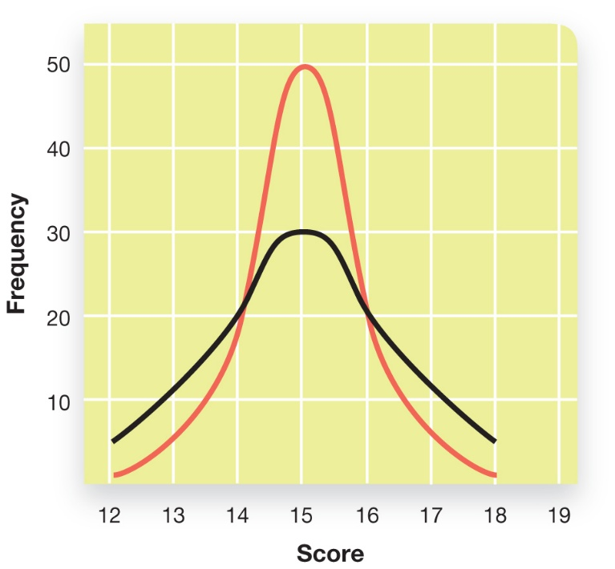
Variability
Figure 2.11 Visualizing Variability
Imagine that these curves show how two classes fared on a 20-point quiz. Both classes averaged scores of 15 points. However, the students in one class (depicted in red) scored much more similarly to one another compared to students in another class (depicted in black), whose scores showed greater variability. The class represented by the black line would have a higher standard deviation.
Notes:
1) Measures of central tendency tell us where scores cluster. However, sometimes scores are more spread out than clustered.
Variability (p. 62) is the degree to which scores are dispersed in a distribution.
2) Because data can be clustered or spread out, researchers report both the mean and variability to help give a better picture of the data.
Standard Deviation (p. 62) is a measure of variability around the mean.
3) Standard deviation is one commonly used measure of variability.
i) It can be thought of as the average distance from the mean.
ii) For example, the GREs are like the SATs, but for graduate school.
a) Someone reports a mean on the GREs of 500 with a standard deviation of 100.
b) This means that most of the scores fall within 100 points of the mean (500) on either side or within 400-600 points.
Long Description:
The details of the graph are as follows:
The x-axis shows the score from 12 to 19 in increments of 1. The y-axis shows the frequency in terms of the number of students from 10 to 50 in increments of 10. The graph shows two lines, one depicted in red which has a higher peak at 50 and is narrow while the other in black which has a smaller peak at 30 and is wider. The curves depict variability in terms of the number of students scoring the highest scores.

Slide 31
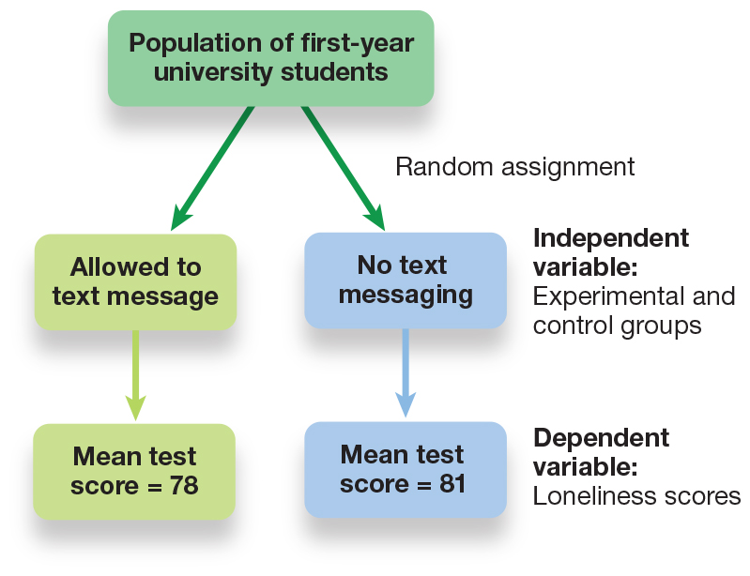
Hypothesis Testing: Evaluating the Outcome of the Study (1 of 2)
Figure 2.13 Testing a Simple Hypothesis
To conduct an experiment on whether texting reduces loneliness, students would be randomly assigned to either text-messaging or no-text-messaging groups. Their average scores on a loneliness scale would then be compared.
Notes:
1) After researchers have described their data, the next step is to see whether the data support their hypothesis.
2) For example, let’s say we wanted to know whether text messaging reduces feelings of loneliness in first-year college students (Figure 2.13).
i) Students who regularly text are randomly selected and put into one of two groups:
a) Those who can text (control group).
b) Those who cannot text (experimental group).
c) In this example, the IV is the two groups (texting and no texting) and the DV is the score on the loneliness measure (higher score = more loneliness).
ii) After 3 days, the students are asked to fill out a survey measuring loneliness.
iii) We find that those who were able to text, scored 3 points below the mean of the group who could not text.
a) Can we conclude texting decreases loneliness?
b) We need to also know the variability in the scores.
Long Description:
To conduct an experiment on whether texting reduces loneliness, the population of first-year university students will be recruited. The students will be divided into two groups. Half of the students will be allowed to do text messaging while the other half will not be allowed to do text messaging. Independent variable refers to Experimental and control groups. Finally the loneliness score will be analyzed by calculating the mean test score.

Slide 32
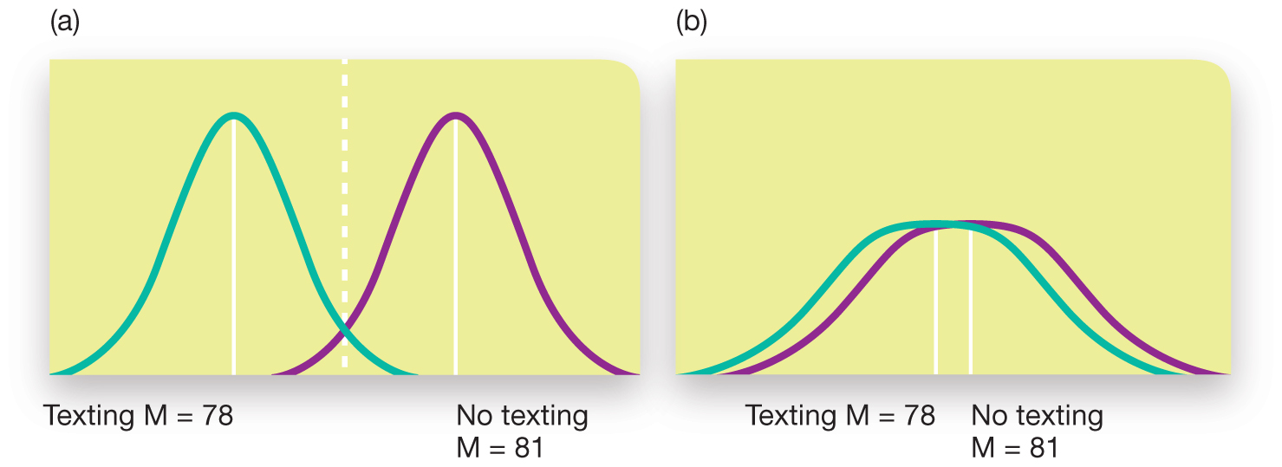
Hypothesis Testing: Evaluating the Outcome of the Study (2 of 2)
Figure 2.14 How Variability Affects Hypothesis Testing
(a) The means (represented by M) differ between the two groups, and there is little overlap in the distribution of scores. When this occurs, the groups are much more likely to be significantly different. (b) Even though the means differ, there is much overlap between the distributions of scores. It is unlikely that these two means would be significantly different.
Notes:
1) The means of the two groups can differ by three points and still be very similar, or differ by three points and be very different (Figure 2.14).
i) The groups are likely to be similar if the scores are very spread out and different if there is little variability in each group.
2) Next, researchers need to determine if the difference in scores between the two groups is significant or has statistical significance (Figure 2.14).
Statistical Significance (p. 64) implies that the mean of the groups are farther apart than you would expect them to be by random chance alone.
i) When each group lacks variability in their scores (each clustered around the mean), we are more likely to find statistical significance.
ii) Conversely, when there is a lot of variability in the scores in each group, we are less likely to find a statistically significant difference between the two.
3) However, we are still only making estimates of significance based on the appearance of the scores. To determine actual significance, researchers analyze data using a hypothesis test.
Hypothesis Test (p. 63) is a statistical method of evaluating whether differences among groups are meaningful, or could have been arrived at by chance alone.
i) Statistical significance testing is based on the researcher making two hypotheses. The goal of researchers is to find differences between groups that are
so large that it is virtually impossible for the null hypothesis to be true; in other words, they are not due to chance.
The Null Hypothesis (p. 64) assumes that any differences between groups (or conditions) are due to chance.
The Experimental Hypothesis (p. 64) assumes that any differences are due to a variable controlled by the experimenter.
Long Description:
The details of the graph are as follows:
In the first graph two curves are slightly overlapped and are separated by dotted lines. The means are three points apart, and the standard deviation is very small. The mean for texting group is 78 and that for the no texting group is 81.
In the second graph, more overlap is shown between the two curves, and the standard deviations are very high. The mean for texting group is 78 and that for the no texting group is 81.

Slide 33

An Introduction to Psychological Science
Third Canadian Edition
Chapter 8
Thought and Language
Copyright © 2021 Pearson Canada, Inc.
Notes:
If this PowerPoint presentation contains mathematical equations, you may need to check that your computer has the following installed:
1) MathType Plugin
2) Math Player (free versions available)
3) NVDA Reader (free versions available)

Slide 34
True or False?
T F 1. People more easily detect male prejudice against females than female against males or female against females.
T F 2. In general, people underestimate how much they really know.
T F 3. It takes less compelling evidence to change our beliefs than it did to create them in the first place.
T F 4. The babbling of an infant at 4 months of age makes it clear whether the infant is French, Korean, or Ethiopian.
T F 5. Some people can write but not read.

Slide 35
T F 6. Many bilinguals report that they have different senses of self, depending on which language they are using.
T F 7. Imagining a physical activity triggers action in the same brain areas that are triggered when actually performing that activity.
T F 8. Only human beings seem capable of insight (the sudden realization of a problem’s solution).
T F 9. Honeybees do a dance to communicate the direction and distance of a new food source to other bees.
T F 10. Apes are capable of communicating meaning by using symbols.

Slide 36
Thinking
Thinking, or cognition, refers to a process that involves knowing, understanding, remembering, and communicating.
Gr. Φρονεω (pr. phroneō) – to think, to mind; to be of opinion; to take thought, be considerate; to entertain sentiments or inclinations of a specific kind, to be minded; to be in a certain frame of mind; to imagine; to heed, pay regard to; to incline to; be set upon, mind

Slide 37
A little more Greek
Mind (Gr. Νουs) – the mind, intellect; understanding, intelligent faculty; intellect, judgment; opinion, sentiment; mind, thought, conception; settled state of mind; frame of mind

Slide 38
The limits of intuition
A bat and a ball cost $1.10 in total. The bat costs $1 more than the ball. How much does the ball cost?
A man bought a horse for $60 and sold it for $70. Then he bought the same horse back for $80 and again sold it, for $90. How much money did he make in the horse business?

Slide 39

Modules
8.1: The Organization of Knowledge
8.2: Problem Solving, Judgment, and Decision Making
8.3: Language and Communication
Login/Shutterstock

Slide 40
8.1 Learning Objectives
Know the key terminology associated with concepts and categories.
Understand theories of how people organize their knowledge about the world.
Understand how experience and culture can shape the way we organize our knowledge.
Apply your knowledge to identify prototypical examples.
Analyze the claim that the language we speak determines how we think.
Notes:
Know the key terminology associated with concepts and categories.
See bold, italicized terms below.
Understand theories of how people organize their knowledge about the world.
First, certain objects and events are more likely to be associated in clusters. The priming effect demonstrates this phenomenon. For example, hearing the word “fruit” makes it more likely that you will think of “apple” than “table.” More specifically, we organize our knowledge about the world through networks consisting of categories with varying levels of specificity. We usually think in terms of basic level categories, but under some circumstances we can either be more or less specific.
Understand how experience and culture can shape the way we organize our knowledge.
There are a number of examples of how culture influences the way we categorize objects. For example, people from North America (and Westerners in general) tend to focus on an individual, or focal objects in a scene, whereas people from Japan tend to focus on how objects are interrelated.
Apply your knowledge to identify prototypical examples.
Students should be able to identify prototypical objects of common categories, as well as those created spontaneously.
Analyze the claim that the language we speak determines how we think.
Researchers have shown that language can influence the way we think at some level, but it cannot entirely shape how we perceive the world. For example, people can categorize colours even if they do not have specific words for them.

Slide 41
Concepts and Categories
Concept (p. 294)
Divided into smaller groups
Categories (p. 294)
Notes:
1) Cognition would not be possible without concepts and categories.
Concept (p. 294) is the mental representation of an object, event, or idea.
2) Concepts are rarely independent.
i) We do not have one concept for chair, table, etc.
a) Instead, each concept can be divided into smaller groups with more precise labels (e.g., wicker chair or dinner table).
b) However, all of these items can be lumped into a single label, furniture.
3) We form such groups through the process of categorization.
Categories (p. 294): clusters of interrelated concepts.

Slide 42
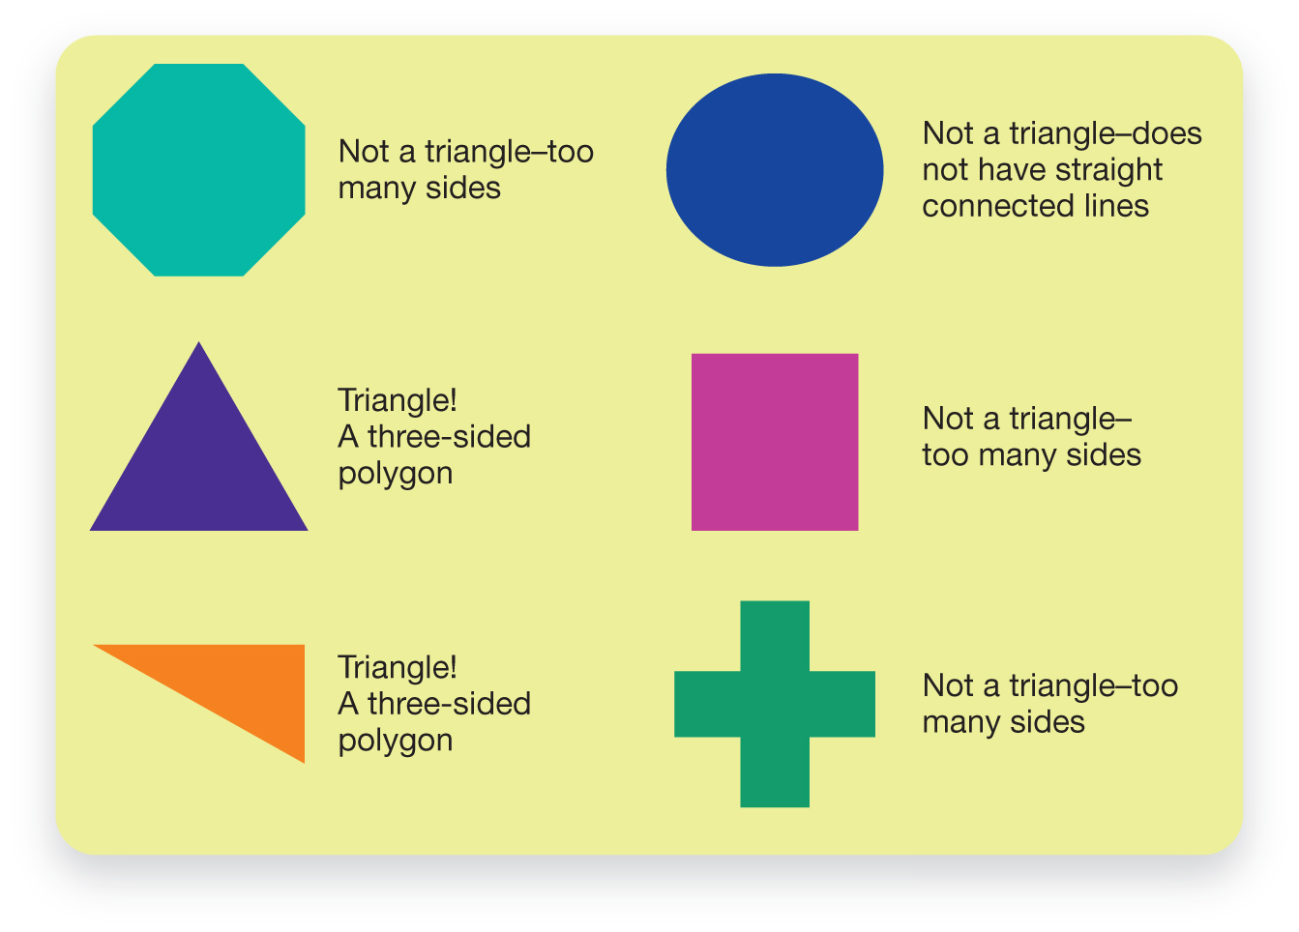
Rule-based Categorization (1 of 2)
Figure 8.1 Using the Definition of a Triangle to Categorize Shapes
Notes:
Rule-based categorization (p. 294): this theory claims that objects or events are categorized according to a certain set of rules or by a specific set of features.
1) Definitions can be a great way of explaining how people categorize items.
i) Knowing the definition of a triangle, we are able to identify triangles mixed in with other shapes (Figure 8.1).
2) However, rule-based categorization doesn’t fully explain how we categorize, such graded membership (Table 8.1).
Graded membership (p. 294) the observation that some concepts appear to make better category members than others.
i) For example, researchers flashed sentences on a screen to which participants responded “yes” or “no."
a) One sentence was, “A sparrow is a bird.”
b) Another sentence was, “A penguin is a bird.”
ii) Almost always, participants said yes faster about the sparrow being a bird.
a) This goes against a rule-based categorization system because both are birds.
b) These results suggest that we have “best examples” for each category.
Long Description:
The figure shows six geometric shapes. The shapes and the definitions are as follows.
Six-sided shape with all sides of the same length: Not a triangle-too many sides
Three-sided shape with all sides of the same length: Triangle! A three-sided polygon
Three-sided shape with all sides of different lengths: Triangle! A three-sided polygon
Circle: Not a triangle-does not have straight connected lines
Four-sided shape with all sides of the same length: Not a triangle – too many sides
“Plus” symbol: Not a triangle- too many sides

Slide 43
Rule-based Categorization (2 of 2)
Table 8.1 Categorizing Objects According to the Definition of Bird
Definition: “[A] feathered, warm-blooded, vertebrate of the class Aves, having a beak and wings, laying eggs and usually able to fly.” (Canadian Oxford Dictionary, 2nd ed., 2005)
Now categorize a set of items by answering yes or no regarding the truth of the following sentences:
1. A sparrow is a bird.
2. An apple is a bird.
3. A penguin is a bird.
Notes:
Rule-based categorization (p. 294): this theory claims that objects or events are categorized according to a certain set of rules or by a specific set of features.
1) Definitions can be a great way of explaining how people categorize items.
Knowing the definition of a triangle, we are able to identify triangles mixed in with other shapes (Figure 8.1).
2) However, rule-based categorization doesn’t fully explain how we categorize, such graded membership (Table 8.1).
Graded membership (p. 294) the observation that some concepts appear to make better category members than others.
i) For example, researchers flashed sentences on a screen to which participants responded “yes” or “no."
One sentence was, “A sparrow is a bird.”
Another sentence was, “A penguin is a bird.”
ii) Almost always, participants said yes faster about the sparrow being a bird.
This goes against a rule-based categorization system because both are birds.
These results suggest that we have “best examples” for each category.

Slide 44
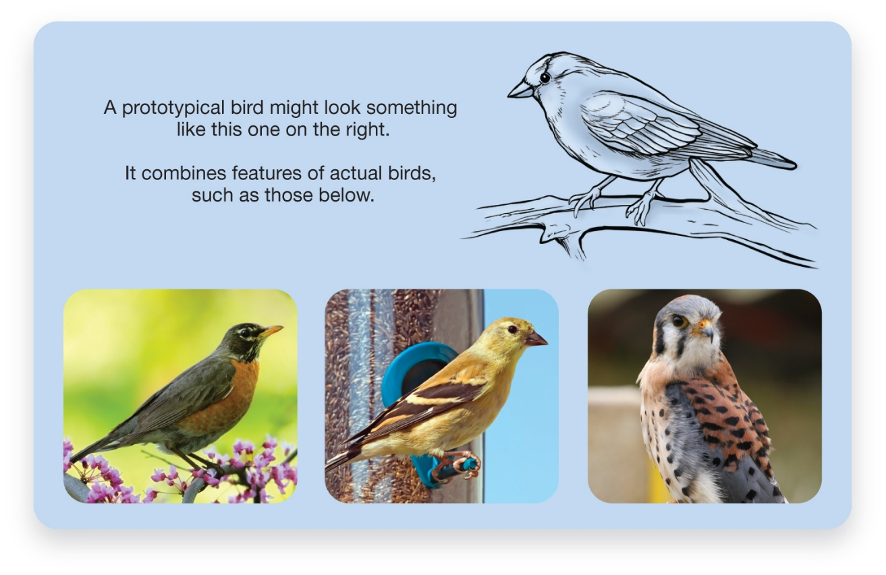
Prototypes: Categorization by Comparison
Figure 8.2 A Prototypical Bird
Source: Left: chatursunil/Shutterstock; centre: Al Mueller/Shutterstock; right: Leo/Shutterstock
Notes:
1) The likely image that comes to mind at the suggestion to imagine a bird is what psychologists call a prototype (Figure 8.2).
Prototypes (p. 316) are mental representations of an average category member.
i) Prototypes allow for classification by resemblance.
a) For example, if you come upon a new creature in the woods and it has wings and flies, you would likely categorize it as a bird.
ii) Rules or definitions are not used; instead we rely on similarities in overall shape and function.
2) The main advantage of prototypes is that they help explain why some category members make better examples than others.
i) For example, ostriches are birds just as much as blue jays, but they do not resemble the rest of the family as well.
3) We are likely to rely on rules (rule-based categorization) when there are complications and resemblances (prototypes) when there are a few major distinctions between items.
i) For example, a bat looks like a bird, but it gives birth instead of laying eggs because it is a mammal.
Long Description:
The figure shows an illustration of a bird. A text alongside the illustration reads “A prototypical bird might look something like this one on the right.”
The figure shows photos of three birds below the illustration. The birds are of different colours and with slight differences in features. A text above the photos reads “It combines features of actual birds, such as those below.”
The bird shown in the illustration is almost the same size as the birds shown in the photos.

Slide 45
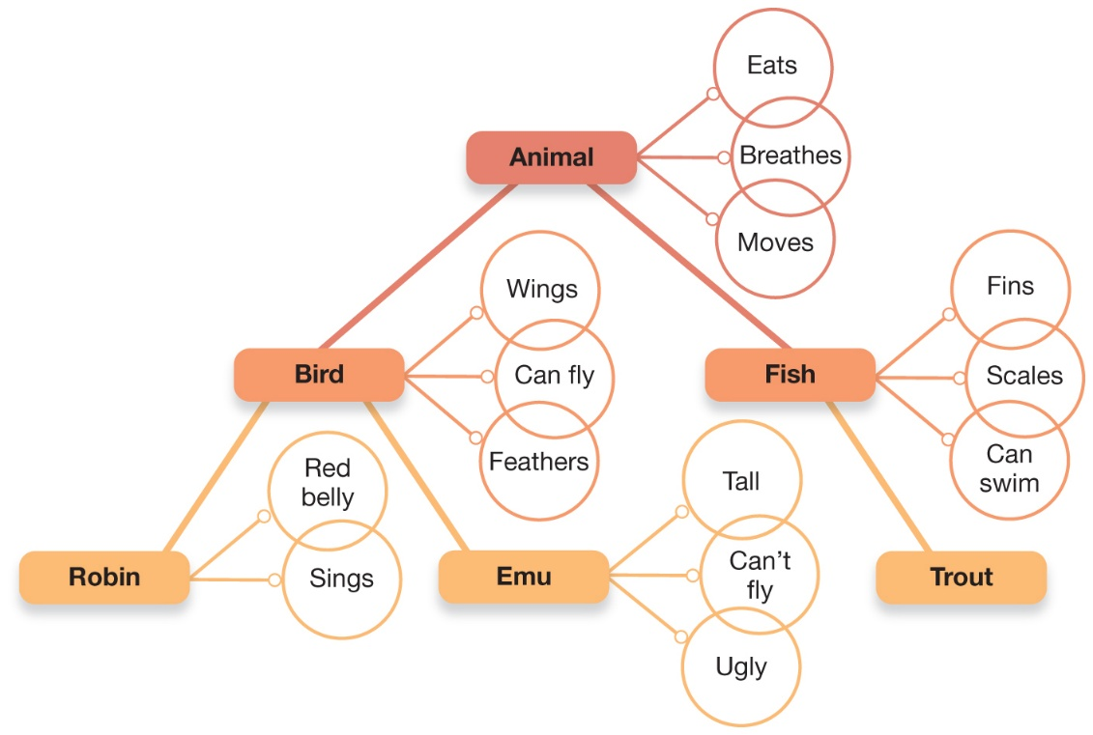
Networks and Hierarchies
Figure 8.3 A Semantic Network Diagram for the Category “Animal”
The nodes include the basic-level categories, Bird and Fish. Another node represents the broader category of Animal, while the lowest three nodes represent the more specific categories of Robin, Emu, and Trout.
Source: Based on Collins, A. M., & Quillian, M. R. (1969). Retrieval time from semantic memory. Journal of Verbal Learning and Verbal Behavior, 8, 240–248.
Notes:
1) The connections among ideas can be represented in a network diagram (Figure 8.3).
Semantic network (p. 296) is an interconnected set of nodes (or concepts) and the links that join them to form a category.
i) Nodes are circles that represent concepts.
ii) Links connect nodes together to represent the structure of a category as well as the relationships among different categories.
a) When concepts are closer together in the network diagram, we are quicker to identify them as true.
b) For example, “A robin is a bird” vs. “A robin is an animal.”
2) These networks are organized in a hierarchy, moving from general to very specific.
i) The basic level category consists of:
a) The terms used most often in conversation.
b) The easiest to pronounce.
c) Prototypes.
d) The level at which most thinking occurs.
Long Description:
The 3-level diagram shows the various nodes. The diagram also shows the characteristics of each node as follows.
Animal: Eats, Breathes, Moves
Bird: Wings, Can fly, Feathers
Robin: Red belly, Sings
Emu: Tall, Can’t fly, Ugly
Fish: Fins, Scales, Can swim
Trout

Slide 46
Working the Scientific Literacy Model: Priming and Semantic Networks (1 of 2)
What do we know about semantic networks?
Priming (p. 297)
How can scientists explain priming effects?
Lexical Decision Task
Notes:
1) What do we know about semantic networks?
i) You may notice the connections within semantic networks anytime you encounter one aspect of a category and other related concepts seem to come to mind. Semantic networks account for priming.
Priming (p. 297) refers to the activation of individual concepts in long-term memory.
2) How can scientists explain priming effects?
i) Psychologists can test for priming through reaction time measurements or or through a method called the lexical decision task. With the lexical decision method,
a volunteer is presented with a string of letters flashed on the computer screen. They respond yes or no as quickly as possible to indicate whether the letters spell a word (see Figure 8.4). Using this method, a volunteer should respond faster that “apple” is a word if it follows the word “fruit” (which is semantically related) than if it follows the word “bus” (which is not semantically related).

Slide 47
Working the Scientific Literacy Model: Priming and Semantic Networks (2 of 2)
Can we critically evaluate this information?
Strength of priming varies
Experiments difficult to replicate
Why is this relevant?
Advertising
Notes:
3) Can we critically evaluate this information?
i) The strength of priming effects can vary a great deal and some published experiments have been very difficult to replicate. While most psychologists agree that priming is an important area of research, there have been very open debates at about the best way to conduct the research and how to interpret the results.
4) Why is this relevant?
i) Priming can be used by advertisers in a controlled way to promote specific behaviours.

Slide 48
Categorization and Experience
Categorization is based on experience
Efficient process
But can also result in errors
Notes:
1) As we are exposed to new stimuli, we instinctively try to organize the stimuli into groups based on similar physical and semantic features.
i) Normally, these procedures lead to fast and accurate categorization. If you see an animal with wings and a beak, you can easily retrieve from memory a bird that you previously saw; doing so will lead you to infer that this new object is a bird, even if it is a type of bird that you might not have encountered before.
ii) However, there are also times when our reliance on previously experienced items can lead us astray. In a series of studies with medical students and practicing physicians, Geoffrey Norman and colleagues at McMaster University found that recent exposure to an example from one category can bias how people diagnose new cases.

Slide 49
Categories and the Brain (1 of 2)
Categories, Memories, and the Brain
Category-specific visual agnosia (CSVA)
Living vs. non-living categories
Notes:
1) Some patients with extensive damage to the temporal lobes displayed trouble identifying visually presented objects such as pictures of animals or vegetables despite the fact that they could still see. This problem is referred to as category-specific visual agnosia (CSVA). The fact that these deficits were for particular categories of objects it suggested that damaging certain parts of the brain could affect the ability to recognize some categories while leaving others unaffected.
2) Early attempts to find a pattern in these patients’ deficits focused on the distinction between living and non-living categories (Figure 8.6). It has been proposed that evolutionary pressures led to the development of specialized circuits in the brain for a small group of categories that were important for our survival. These categories included animals, fruits and vegetables, members of our own species, and possibly tools.

Slide 50
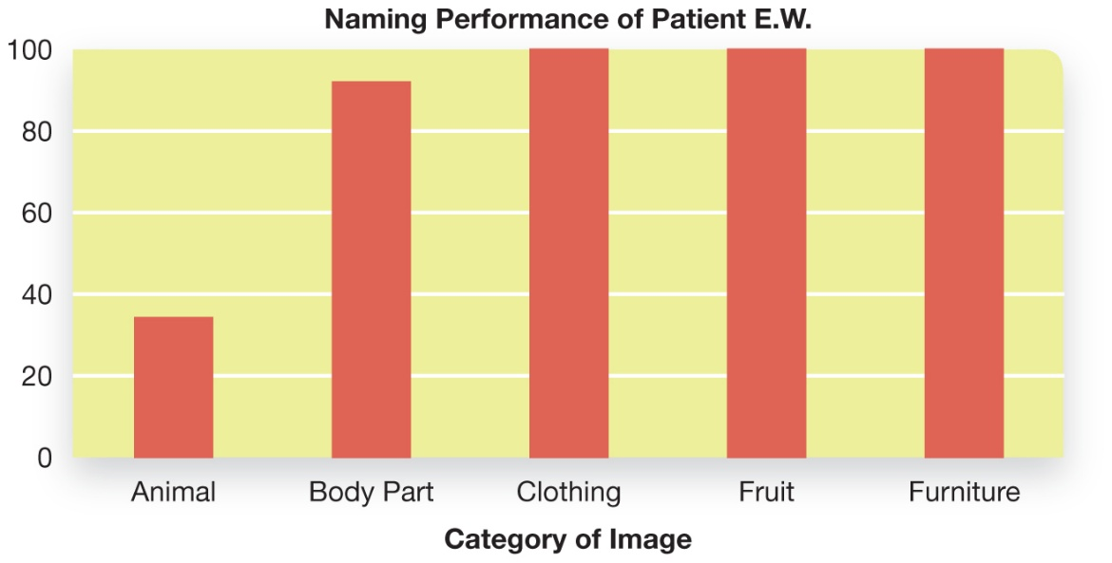
Categories and the Brain (2 of 2)
Figure 8.6 Naming Errors for a CSVA Patient
Patients with CSVA have problems identifying members of specific categories. When asked to identify the object depicted by different line drawings, patient E.W. showed a marked impairment for the recognition of animals. Her ability to name items from other categories demonstrated that her overall perceptual abilities were preserved.
Source: Based on data from Caramazza, A., & Mahon, B. Z. (2003). The organization of conceptual knowledge: the evidence from category-specific semantic deficits. Trends in Cognitive Sciences, 7(8), 354–361.
Notes:
1) Some patients with extensive damage to the temporal lobes displayed trouble identifying visually presented objects such as pictures of animals or vegetables despite the fact that they could still see. This problem is referred to as category-specific visual agnosia (CSVA). The fact that these deficits were for particular categories of objects it suggested that damaging certain parts of the brain could affect the ability to recognize some categories while leaving others unaffected.
2) Early attempts to find a pattern in these patients’ deficits focused on the distinction between living and non-living categories (Figure 8.6). It has been proposed that evolutionary pressures led to the development of specialized circuits in the brain for a small group of categories that were important for our survival. These categories included animals, fruits and vegetables, members of our own species, and possibly tools.
Long Description:
The x-axis of the chart shows the categories of images. The y-axis shows the performance of the patient on a scale of 0 to 100. The chart shows vertical bars for each category. The categories and the patient’s approximate performance are as follows.
Animal: 35
Body part: 92
Clothing: 100
Fruit: 100
Furniture: 100

Slide 51
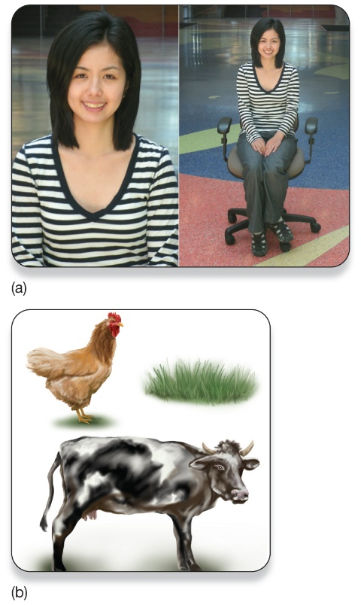
Culture and Categories (1 of 2)
Figure 8.7 Your Culture and Your Point of View
(a) Which of these two pictures do you think a North American would be more likely to take? (b) Which two go together?
Source: (b) Adapted from Nisbett, R. E., & Masuda, T. (2003). Culture and point of view. Proceedings of the National Academy of Sciences, 100(19), 11163–11170. Copyright © 2003. Reprinted by permission of National Academy of Sciences.
Blend Images/Shutterstock
Notes:
1) How we categorize objects depends greatly on what we have learned about these objects from others in our culture.
i) For example, researchers asked individuals from traditional villages to identify a variety of plants and animals that were extremely relevant to their diet, medicine, and safety.
a) These individuals referred to plants and animals at a more specific level than North American university students would.
ii) Culture also influences how objects in our world relate to one another.
2) Cultural differences in how people think and categorize items has led to the idea of linguistic relativity.
Linguistic relativity (or the Whorfian hypothesis) (p. 301): the theory that the language we use determines how we understand (and categorize) the world.
i) For example, cows are sometimes referred to as “livestock” or “food animals” in Canada.
ii) Neither category would apply in India, where cows are viewed as sacred.
3) How objects relate to each other can also differ greatly by culture.
i) Americans tend to focus on an object, whereas Japanese people tend to view objects in relation to their surroundings.
ii) For example, researchers asked American and Japanese college students to take a picture of someone from any angle, perspective, etc. they wanted (Figure 8.7a).
a) American students were more likely to take close-ups, whereas Japanese students included surrounding objects.
iii) American students were also more likely to group cows and chickens together (because both are animals), whereas Japanese students were more likely to group cows and grass (because that’s what they eat) (Figure 8.7b).
4) There is also a difference in brain functioning between cultures when viewing and categorizing objects (Figure 8.8).
i) For example, when Americans view a picture of an animal against a backdrop of trees and grass, brain regions involved in processing both objects and background become active.
ii) Whereas only the brain regions involved with background processes become active in East Asians.
Long Description:
Part A: Both photos are of the same woman. The first photo is a close-up of the woman. The second photo is taken from a distance and the woman is seated on a chair with her hands on her lap.
Part B: One illustration is of a hen and a green grass. The other illustration is of a cow.

Slide 52
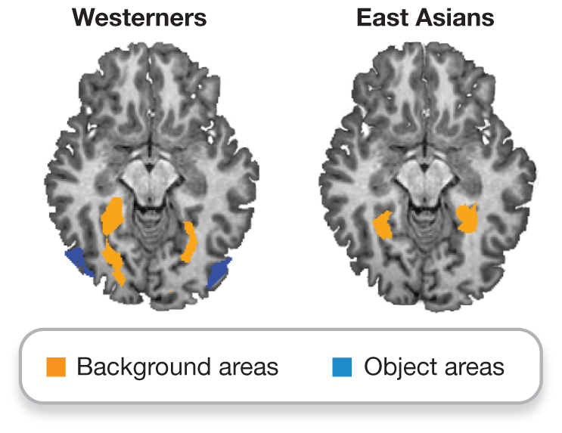
Culture and Categories (2 of 2)
Figure 8.8 Brain Activity Varies by Culture
Brain regions that are involved in object recognition and processing are activated differently in people from Western and Eastern cultures. Brain regions that are involved in processing individual objects are more highly activated when Westerners view focal objects against background scenery, whereas people from East Asian countries appear to attend to background scenery more closely than focal objects.
Notes:
1) How we categorize objects depends greatly on what we have learned about these objects from others in our culture.
i) For example, researchers asked individuals from traditional villages to identify a variety of plants and animals that were extremely relevant to their diet, medicine, and safety.
a) These individuals referred to plants and animals at a more specific level than North American university students would.
ii) Culture also influences how objects in our world relate to one another.
2) Cultural differences in how people think and categorize items has led to the idea of linguistic relativity.
Linguistic relativity (or the Whorfian hypothesis) (p. 301): the theory that the language we use determines how we understand (and categorize) the world.
i) For example, cows are sometimes referred to as “livestock” or “food animals” in Canada.
ii) Neither category would apply in India, where cows are viewed as sacred.
3) How objects relate to each other can also differ greatly by culture.
i) Americans tend to focus on an object, whereas Japanese people tend to view objects in relation to their surroundings.
ii) For example, researchers asked American and Japanese college students to take a picture of someone from any angle, perspective, etc. they wanted (Figure 8.7a).
a) American students were more likely to take close-ups, whereas Japanese students included surrounding objects.
iii) American students were also more likely to group cows and chickens together (because both are animals), whereas Japanese students were more likely to group cows and grass (because that’s what they eat) (Figure 8.7b).
4) There is also a difference in brain functioning between cultures when viewing and categorizing objects (Figure 8.8).
i) For example, when Americans view a picture of an animal against a backdrop of trees and grass, brain regions involved in processing both objects and background become active.
ii) Whereas only the brain regions involved with background processes become active in East Asians.

Slide 53
Myths in Mind: How Many Words for Snow?
Inuit have many words for snow
Aput = snow on the ground
Gana = falling snow
Exaggerated to dozens of words
Canadians have many words for snow
Sticky snow
Drifting snow
Yellow snow
Notes:
1) Early in the 19th century, anthropologist Franz Boas observed that the Inuit had many different words for snow.
i) For example, aput means snow that is on the ground and gana means falling snow.
2) This story was repeated and often exaggerated upon with claims that Inuit people had dozens of words for different types of snow.
i) It was thought that the Inuit perceive snow differently in comparison to those who are not near snow year-round.
ii) Scholars used this example to argue that language determines how people categorize the world.
3) However, the reality is that the Inuit categorize snow the same way a person from the rest of Canada does.
i) For example, people in Winnipeg can tell the difference between snow on the ground and falling snow, as well as sticky snow, drifting snow, yellow snow, and so on.
a) In this case, the linguistic relativity hypothesis is incorrect.
b) The difference in vocabulary for snow does not lead to differences in perception.

Slide 54
8.2 Learning Objectives
Know the key terminology of problem solving and decision making.
Understand the characteristics that problems have in common.
Understand how obstacles to problem solving are often self-imposed.
Apply your knowledge to determine if you tend to be a maximizer or a satisficer.
Analyze whether human thought is primarily logical or intuitive.
Notes:
Know the key terminology of problem solving and decision making.
See bold, italicized terms below.
Understand the characteristics that problems have in common.
All problems have initial states and goal states. We use operators to achieve goal states. Also, many problems include subgoals. Problems can range from well-defined to ill-defined.
Understand how obstacles to problem solving are often self-imposed.
Many obstacles arise from the individual’s mental set, which occurs when a person focuses on only one known solution and does not consider alternatives. Similarly, functional fixedness can arise when an individual does not consider alternative uses for familiar objects.
Apply your knowledge to determine if you tend to be a maximizer or a satisficer.
Students should be able to rate their (dis)agreement with a number of statements, average their score, and reflect on their score as to whether they are more of a maximizer or satisficer.
Analyze whether human thought is primarily logical or intuitive.
This Module provides ample evidence that humans are not always logical. Heuristics are helpful decision-making and problem-solving tools, but they do not follow logical principles. Even so, the abundance of heuristics does not mean that humans are never logical; instead, they simply point to the limits of our rationality.

Slide 55
Defining and Solving Problems (1 of 2)
Problem solving (p. 304)
Algorithms (p. 304)
Heuristics (p. 304)
Notes:
1) Despite how different problems may seem, they all share some key components.
Problem solving (p. 304) means accomplishing a goal when the solution or the path to the solution is not clear.
2) There appear to be two basic strategies we use to solve problems.
i) One is more objective, logical, and slower.
a) For example, listing and pros and cons of dating someone.
Algorithms (p. 304) are problem-solving strategies based on a series of rules.
ii) The other is more subjective, intuitive, and quicker.
a) For example, envisioning what it would be like to date the person.
Heuristics (p. 304) problem solving-strategies that stem from prior experiences and provide an educated guess as to what is the most likely solution.
3) For example, think about how you might play the children’s word-game known as hangman (Figure 8.9).
i) The goal state is to spell the word.
ii) In the initial state, you have none of the letters or other clues to guide you.
iii) Your obstacles are to overcome blanks without guessing the wrong letters.
iv) Using an algorithm, you could pick A, B, C, D, etc.
a) But you would probably lose.
v) Using another algorithm, you could determine which letters are most commonly used and guess those.
a) According to the Oxford English Dictionary, the most common letter is E followed by A, R, and I.
vi) Using a heuristic, you might discover the last letter is G and guess the next-to-last letter is N because you know many words ending in –ing.
4) Most problems can be solved with either algorithms or heuristics, or a combination of both.

Slide 56
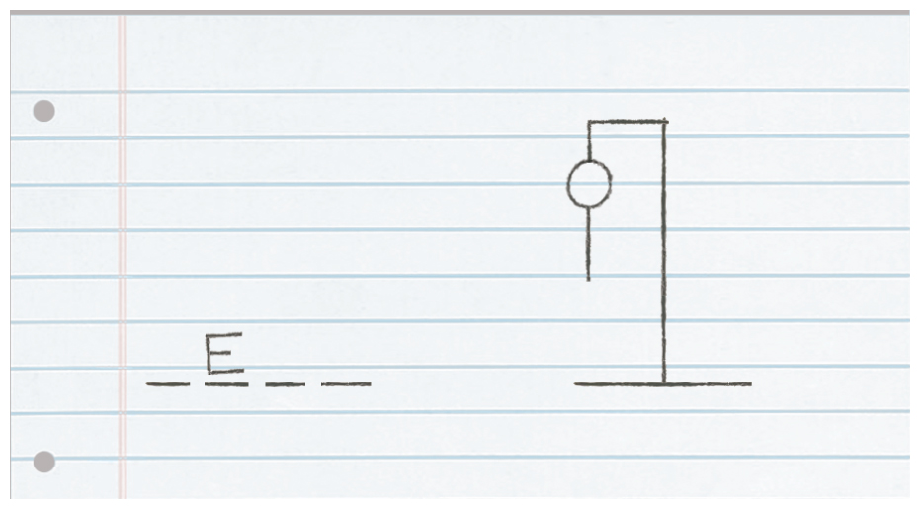
Defining and Solving Problems (2 of 2)
Figure 8.9 Problem Solving in Hangman
In a game of Hangman, your job is to guess the letters in the word represented by the four blanks to the left. If you get a letter right, your opponent will put it in the correct blank. If you guess an incorrect letter, your opponent will draw a body part on the stick figure. The goal is to guess the word before the entire body is drawn.
Notes:
1) Despite how different problems may seem, they all share some key components.
Problem solving (p. 304) means accomplishing a goal when the solution or the path to the solution is not clear.
2) There appear to be two basic strategies we use to solve problems.
i) One is more objective, logical, and slower.
a) For example, listing and pros and cons of dating someone.
Algorithms (p. 304) are problem-solving strategies based on a series of rules.
ii) The other is more subjective, intuitive, and quicker.
a) For example, envisioning what it would be like to date the person.
Heuristics (p. 304) problem solving-strategies that stem from prior experiences and provide an educated guess as to what is the most likely solution.
3) For example, think about how you might play the children’s word-game known as hangman (Figure 8.9).
i) The goal state is to spell the word.
ii) In the initial state, you have none of the letters or other clues to guide you.
iii) Your obstacles are to overcome blanks without guessing the wrong letters.
iv) Using an algorithm, you could pick A, B, C, D, etc.
a) But you would probably lose.
v) Using another algorithm, you could determine which letters are most commonly used and guess those.
a) According to the Oxford English Dictionary, the most common letter is E followed by A, R, and I.
vi) Using a heuristic, you might discover the last letter is G and guess the next-to-last letter is N because you know many words ending in –ing.
4) Most problems can be solved with either algorithms or heuristics, or a combination of both.

Slide 57
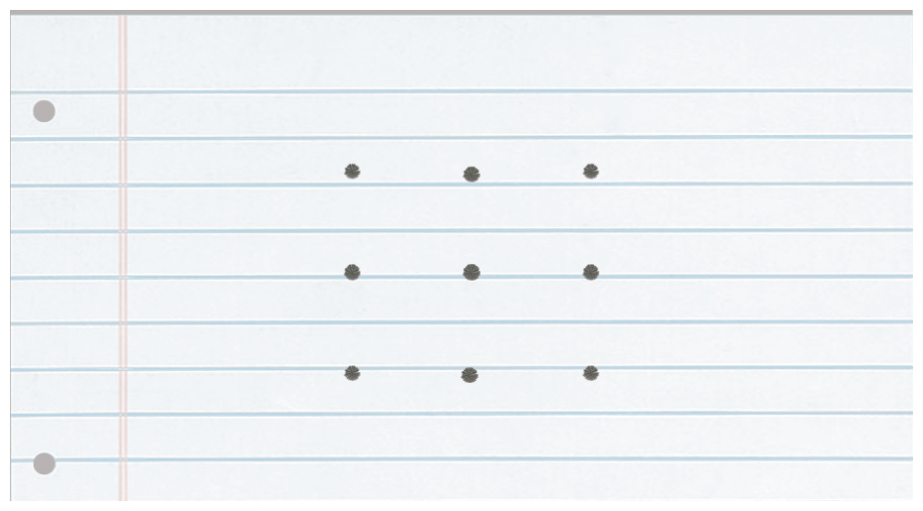
Cognitive Obstacles (1 of 3)
Figure 8.10 The Nine-Dot Problem
Connect all nine dots using only four straight lines and without lifting your pen or pencil (Maier, 1930). The solution to the problem can be seen in Figure 8.11.
Source: Maier, N. F. (1930). Reasoning in humans. I. On direction. Journal of Comparative Psychology, 10(2), 115–143. American Psychological Association.
Notes:
1) Some of the simplest (and maybe most frustrating) forms of cognitive obstacles are self-imposed.
i) Sometimes we have trouble “thinking outside of the box.”
2) A great example of this is the nine-dot problem (Figure 8.10).
i) The goal is to connect all nine dots using only four straight lines and without lifting your pen off the paper.
ii) Most people impose limitations on where the lines can go, even though those limits are not part of the rules.
a) People assume the dots mark the boundaries that they must stay in, but solving the problem requires to go outside the boundaries (Figure 8.11).
3) Routine solutions can be helpful, but they can also impose cognitive barriers.
Mental set (p. 305) is a cognitive obstacle that occurs when an individual attempts to apply a routine solution to what is actually a new type of problem.
i) A mental set can also occur when an individual applies a routine solution when a much easier solution is possible (Figure 8.12).
4) Another obstacle is when we can only think of one function for an operator.
Functional fixedness (p. 305-306) occurs when an individual identifies a potential object or technique that could potentially solve a problem but can think of only its most obvious function.
i) For example, imagine you are asked to tie two strings together that are hanging from the ceiling (Figure 8.13; solution: Figure 8.16).
a) However, once you grab one string you cannot let go of it and you cannot reach the second string. There is a table next to you with a pair of pliers, a piece of paper, and a ball of cotton.
b) Many people don’t think of using the pliers as a weight on a string to get it to swing into reach because that’s not a normal use for pliers.

Slide 58
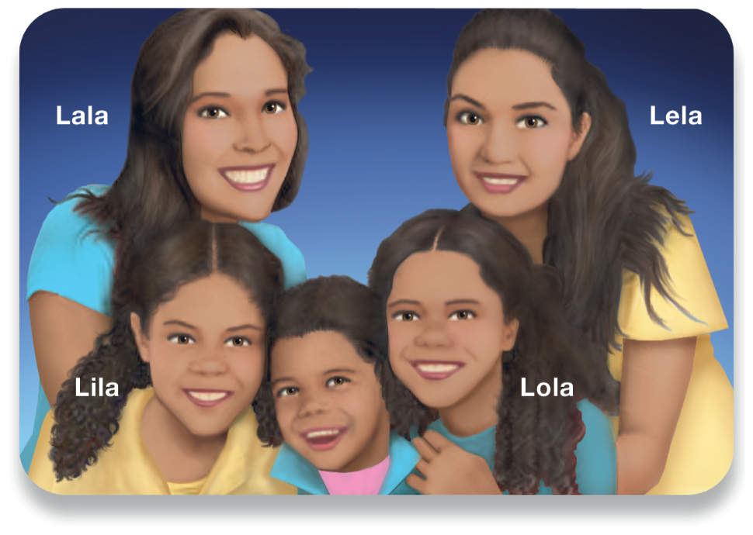
Cognitive Obstacles (2 of 3)
Figure 8.12 The Five-Daughter Problem
Maria’s father has five daughters: Lala, Lela, Lila, and Lola. What is the fifth daughter’s name?
The fifth daughter’s name is Maria.
Notes:
1) Some of the simplest (and maybe most frustrating) forms of cognitive obstacles are self-imposed.
i) Sometimes we have trouble “thinking outside of the box.”
2) A great example of this is the nine-dot problem (Figure 8.10).
i) The goal is to connect all nine dots using only four straight lines and without lifting your pen off the paper.
ii) Most people impose limitations on where the lines can go, even though those limits are not part of the rules.
a) People assume the dots mark the boundaries that they must stay in, but solving the problem requires to go outside the boundaries (Figure 8.11).
3) Routine solutions can be helpful, but they can also impose cognitive barriers.
Mental set (p. 305) is a cognitive obstacle that occurs when an individual attempts to apply a routine solution to what is actually a new type of problem.
i) A mental set can also occur when an individual applies a routine solution when a much easier solution is possible (Figure 8.12).
4) Another obstacle is when we can only think of one function for an operator.
Functional fixedness (p. 305-306) occurs when an individual identifies a potential object or technique that could potentially solve a problem but can think of only its most obvious function.
i) For example, imagine you are asked to tie two strings together that are hanging from the ceiling (Figure 8.13; solution: Figure 8.16).
a) However, once you grab one string you cannot let go of it and you cannot reach the second string. There is a table next to you with a pair of pliers, a piece of paper, and a ball of cotton.
b) Many people don’t think of using the pliers as a weight on a string to get it to swing into reach because that’s not a normal use for pliers.

Slide 59
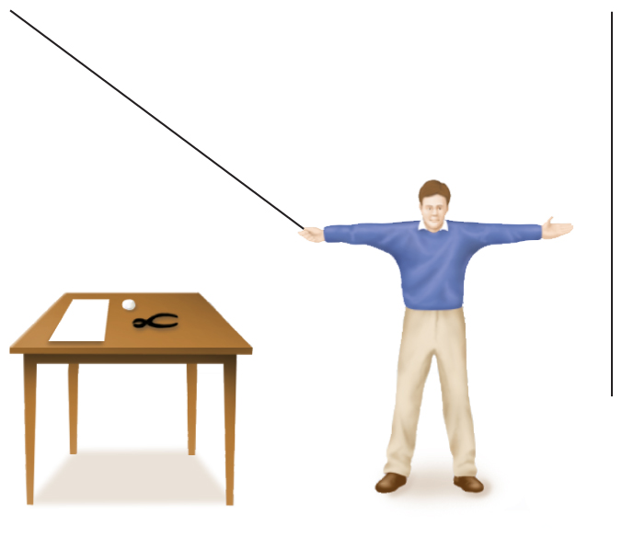
Cognitive Obstacles (3 of 3)
Figure 8.13 The Two-String Problem
Imagine you are standing between two strings and need to tie them together. The only problem is that you cannot reach both strings at the same time (Maier, 1931). In the room with you is a table, a piece of paper, a pair of pliers, and a ball of cotton. What do you do? For a solution, see Figure 8.16.
Notes:
1) Some of the simplest (and maybe most frustrating) forms of cognitive obstacles are self-imposed.
i) Sometimes we have trouble “thinking outside of the box.”
2) A great example of this is the nine-dot problem (Figure 8.10).
i) The goal is to connect all nine dots using only four straight lines and without lifting your pen off the paper.
ii) Most people impose limitations on where the lines can go, even though those limits are not part of the rules.
a) People assume the dots mark the boundaries that they must stay in, but solving the problem requires to go outside the boundaries (Figure 8.11).
3) Routine solutions can be helpful, but they can also impose cognitive barriers.
Mental set (p. 305) is a cognitive obstacle that occurs when an individual attempts to apply a routine solution to what is actually a new type of problem.
i) A mental set can also occur when an individual applies a routine solution when a much easier solution is possible (Figure 8.12).
4) Another obstacle is when we can only think of one function for an operator.
Functional fixedness (p. 305-306) occurs when an individual identifies a potential object or technique that could potentially solve a problem but can think of only its most obvious function.
i) For example, imagine you are asked to tie two strings together that are hanging from the ceiling (Figure 8.13; solution: Figure 8.16).
a) However, once you grab one string you cannot let go of it and you cannot reach the second string. There is a table next to you with a pair of pliers, a piece of paper, and a ball of cotton.
b) Many people don’t think of using the pliers as a weight on a string to get it to swing into reach because that’s not a normal use for pliers.
Long Description:
The illustration shows a standing man holding a string with his right hand. His left hand is outstretched and a second string dangles beyond his extended hand. To his right is a table on top of which are a piece of paper, a pair of pliers, and a ball of cotton.

Slide 60
Representativeness and Availability
Conjunction fallacy (p. 308)
Representativeness heuristic (p. 308)
Availability heuristic (p. 308)
Notes:
1) We often misjudge probabilities and frequencies.
i) For example:
Linda is 31 years old, single, outspoken, and very bright. She majored in philosophy. As a student, she was deeply concerned
with issues of discrimination and social justice, and also participated in antinuclear demonstrations. Which is more likely?
a. Linda is a bank teller.
b. Linda is a bank teller and is active in the feminist movement.
ii) In one study, more than 80% of students chose B, even though A is more likely.
iii) This is because the world has a certain number of bank tellers (A), which is the base rate.
a) Among this group, there will be a certain number who are also feminists (Figure 8.15).
The conjunction fallacy (p. 308) reflects the mistaken belief that finding a specific member in two overlapping categories is more likely than finding any number of one of the larger, general categories.
2) The conjunction fallacy demonstrates the use of the representativeness heuristic.
Representativeness heuristic (p. 308) making judgments of likelihood based on how well an example represents a specific category.
i) In the bank teller example, there are no descriptors of a bank teller, but there are for social activism, which could represent a feminist.
a) Therefore, the common judgment of B is based on representativeness.
3) Another heuristic we use to make judgments involves examples that are readily available, giving us the impression they happen frequently.
Availability heuristic (p. 308) entails estimating the frequency of an event based on how easily examples of it come to mind.
i) For example, researchers asked volunteers which was more frequent in the English language:
a) Words that begin with the letter K
b) Words that have K as the third letter
ii) Most chose A, even though the correct answer is B.
a) It is easier to recall words that start with K.
4) Although heuristics can lead us to make inaccurate judgments, they also help us to make quick and correct judgments.
i) For example, the same participants were asked which was more common in the English language:
a) Words that begin with the letter K
b) Words that begin with the letter T
ii) Most subjects choose the correct answer, B.
5) Real world examples of availability examples abound; we overestimate the risks of each event because they easily come to mind.
i) For example, police brutality, shark attacks, kidnapping, and terrorist attacks.

Slide 61
Anchoring Effects
Anchoring effect (p. 310)
In what year did British Columbia become part of Canada?
More affected when generated by individual
Notes:
1) Some heuristics are based on how problems are presented.
i) For example, judgments can be influenced by wording, the variety of multiple-choice options, and frames of reference.
Anchoring effect (p. 310) occurs when an individual attempts to solve a problem involving numbers and uses previous knowledge to keep (i.e., anchor) the response within a limited range.
2) For example, imagine that you are asked to name the year in which British Columbia became part of Canada. Although most of you would, of course, excitedly jump from your chair and shout, "1871!" the rest might assume that if Canada became a country in 1867, then B.C. likely joined a few years after that. In this latter case, the birth of our country in 1867 served as an anchor for the judgment about when B.C. joined Confederation.
3) Anchors are more effective when generated by the individual making the judgments, but they can also have effects when introduced by the experimenter.
i) For example, researchers asked the same question to two groups, using a different anchor:
a) What percentage of African nations belongs to the United Nations? Is it greater than or less than 10 percent? What do you think the exact percentage is?
b) What percentage of African nations belongs to the United Nations? Is it greater than or less than 65 percent? What do you think the exact percentage is?
ii) Those in group A estimated the number to be about 25 percent, where those in group B guessed around 45 percent.

Slide 62
Framing Effects (1 of 2)
Decision-making influenced by how problem is framed (p. 310)
Example: Vaccine A vs. Vaccine B
Notes:
1) Decision making can be influenced by how a problem is worded or framed.
2) Imagine that you are a selfless doctor volunteering in a village in a disease-plagued part of Africa (Figure 8.18).
i) You have two treatment options. Vaccine A has been used before; you know that it will save 200 of the 600 villagers. Vaccine B is untested; it has a 33% chance of saving all 600 people and a 67% chance of saving no one. Which option would you choose?
ii)Now let's suppose that you are given two different treatment options for the villagers. Treatment C has been used before and will definitely kill 67% of the villagers. Treatment D is untested; it has a 33% chance of killing none of the villagers and a 67% chance of killing them all. Which option would you choose?
iii) Most people choose the vaccine that will definitely save 200 people (Vaccine A) and the treatment that has a chance of killing no one (Treatment D). This tendency is interesting because options A and C are identical as are options B and D. As you can see by looking at Figure 8.18, the only difference between them is that one is framed in terms of saving people and the other is framed in terms of killing people. Yet, people become much more risk-averse when the question is framed in terms of potential losses (or deaths).

Slide 63
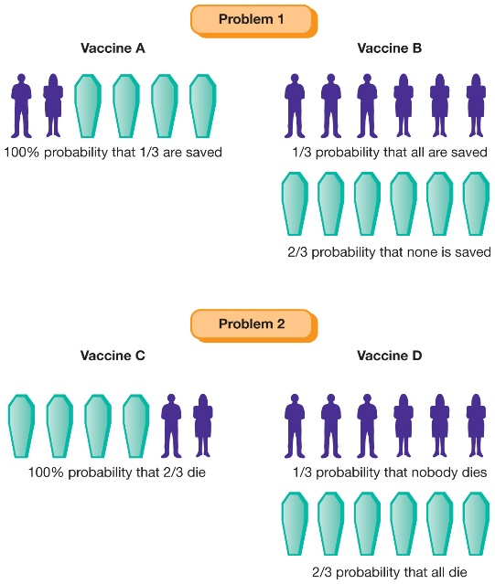
Framing Effects (2 of 2)
Figure 8.18 Framing Effects
When people are asked which vaccine or treatment they would use to help a hypothetical group of villagers, the option they select is influenced by how the question is worded or framed. If the question is worded in terms of saving villagers, most people choose Vaccine A. If the question is worded in terms of killing villagers, most people choose Treatment D.
Source: Wade, C., & Tavris, C. (2002). Invitation to Psychology, 2nd ed., ©2002, p. 121. Adapted and electronically reproduced by permission of Pearson Education, Inc., Upper Saddle River, New Jersey.
Notes:
1) Decision making can be influenced by how a problem is worded or framed.
2) Imagine that you are a selfless doctor volunteering in a village in a disease-plagued part of Africa (Figure 8.18).
i) You have two treatment options. Vaccine A has been used before; you know that it will save 200 of the 600 villagers. Vaccine B is untested; it has a 33% chance of saving all 600 people and a 67% chance of saving no one. Which option would you choose?
ii)Now let's suppose that you are given two different treatment options for the villagers. Treatment C has been used before and will definitely kill 67% of the villagers. Treatment D is untested; it has a 33% chance of killing none of the villagers and a 67% chance of killing them all. Which option would you choose?
iii) Most people choose the vaccine that will definitely save 200 people (Vaccine A) and the treatment that has a chance of killing no one (Treatment D). This tendency is interesting because options A and C are identical as are options B and D. As you can see by looking at Figure 8.18, the only difference between them is that one is framed in terms of saving people and the other is framed in terms of killing people. Yet, people become much more risk-averse when the question is framed in terms of potential losses (or deaths).
Long Description:
The illustration shows two problems and the use of 4 vaccines.
Problem 1
Vaccine A: The figure shows the silhouettes of 2 people and 4 caskets. A note reads “100 percent probability that one-third are saved.”
Vaccine B: One figure shows the silhouettes of 6 people. A note reads “One-third probability that all are saved.” A second figure shows 6 caskets. A note reads “Two-third probability that none is saved.”
Problem 2
Vaccine C: The figure shows 4 caskets and silhouettes of two people. A note reads “100 percent probability that two-third die.”
Vaccine D: One figure shows the silhouettes of 6 people. A note reads “One-third probability that nobody dies.” A second figure shows 6 caskets. A note reads “Two-third probability that all die.”

Slide 64
Belief Perseverance and Confirmation Bias
Belief perseverance (p. 310)
Confirmation bias (p. 311)
Can dramatically influence beliefs, especially for complex, emotionally-charged issues (e.g. politics)
Notes:
1) Heuristics help us make decisions as efficiently as possible.
i) Knowing the errors associated with heuristics allows us to improve our critical thinking by evaluating our solutions, judgments, and decisions.
Belief Perseverance and Confirmation Bias
Belief perseverance (p. 310) occurs when an individual remains committed to their decision or belief even in the face of evidence against it.
1) For example, you and several friends sit down to play poker with an old deck of cards.
i) The first dealer counts the deck and gets 51 cards (short), but on the second count he gets 52 and begins to deal.
a) The dealer exhibited belief perseverance by ignoring the first count of 51 counts and accepting the 52 card count because this was the correct amount needed.
Confirmation bias (p. 311) occurs when an individual searches for (or pays attention to) only evidence that will confirm his or her beliefs instead of evidence that might disconfirm them.
2) Confirmation bias involves the search for a particular type of evidence, whereas belief perseverance involves errors in the way of evaluating evidence that already exists.
i) In the case of the dealer, he only sought out confirmatory evidence.
3) Confirmation bias and belief perseverance can act together to dramatically influence a person’s beliefs, especially in relation to complex, emotionally-charged areas (e.g., politics).
i) We tend to treat evidence in ways that minimize negative or uncomfortable feelings while maximizing positive feelings.
ii) In one study, participants were asked to complete a questionnaire about political beliefs and then to browse websites while researchers tracked their activity. Participants spent significantly more time exploring webpages that were consistent with their beliefs, even when those websites were generally believed to be of poorer quality.
a) Participants in this study were biased toward confirming their beliefs, not becoming more informed.

Slide 65
Working the Scientific Literacy Model: Maximizing and Satisficing in Complex Decisions (1 of 3)
What do we know about maximizing and satisficing?
Two types of consumers
Satisficers = “good enough”
Maximizers = evaluate every option
Paradox of choice
How can scientists explain maximizing and satisficing?
Notes:
1) The advantage of living in a technologically advanced, democratic society includes the ability to make so many decisions for ourselves.
i) The downside is that there are usually too many choices to consider them all.
ii) This results in two types of consumers:
a) Satisficers are those who seek to make decisions that are “good enough.”
b) Maximizers are those who attempt to evaluate every option for every choice until they find the perfect fit.
2) What do we know about maximizing and satisficing?
i) Given the time and effort put in seeking out the best option, many believe the maximizer would be the most satisfied shopper, but this is often not the case.
a) Paradox of choice: the observation that more choices can lead to less satisfaction.
ii) In one study, researchers questioned recent college graduates about their job search process.
a) Maximizers averaged 20% higher salaries but were less happy about their jobs than satisficers.

Slide 66
Working the Scientific Literacy Model: Maximizing and Satisficing in Complex Decisions (2 of 3)
How can scientists explain maximizing and satisficing?
Table 8.2 Satisfaction of Maximizers and Satisficers
(Blank) | 6 Alternatives | 30 Alternatives | Difference
Maximizers | 5.64 | 4.73 | -0.91
Satisficers | 5.44 | 6.00 | +0.46
Source: Adapted from Dar-Nimrod et al. (2009). The Maximization Paradox: The costs of seeking alternatives. Personality and Individual Differences, 46, 631–635, Figure 1 and Table 1.
Notes:
1) How can scientists explain maximizing the satisficing?
i) Scientists have participants read vignettes that include a trade-off between number of choices and effort.
a) For example,
Your cleaning supplies (e.g., laundry detergent, rags, carpet cleaner, dish soap, toilet paper, glass cleaner) are running low. You have the option of going to the nearest grocery store (5 minutes away), which offers 4 alternatives for each of the items you need, or you can drive to the grand cleaning superstore (25 minutes away), which offers 25 different alternatives for each of the items (for approximately the same price). Which store would you go to?
b) Maximizers are much more likely to spend the extra time and effort to have more choices.
ii) Another study told students they could sample only one piece of chocolate from either an array of 6 pieces or 30 pieces (Table 8.2).
a) Maximizers are happier when they can only choose from 6 pieces and satisficers are happier when they chose from 30 pieces.

Slide 67
Working the Scientific Literacy Model: Maximizing and Satisficing in Complex Decisions (3 of 3)
Can we critically evaluate this information?
Maximizers might expect more
Correlational research
Why is this relevant?
Planning for the future
Notes:
1) Can we critically evaluate this information?
i) One reason for the dissatisfaction of maximizers might be because they invest more so they expect more from the outcome.
a) For example, if a maximizer and a satisficer both buy a digital camera for $75, the maximizer will feel like s/he overpaid because of the extra time and effort put in to have the same product.
ii) However, it is important to note this is only quasi-experimental research.
a) People cannot be made maximizers or satisficers; they either already are or not.
b) Therefore, we cannot say what causes what; it could be that maximizers tend to be less satisfied, which leads to maximizing behaviour.
2) Why is this relevant?
i) Recent research shows that maximizers are more likely to plan effectively for the future (career, retirement, life satisfaction, well-being).

Slide 68
8.3 Learning Objectives
Know the key terminology from the study of language.
Understand how language is structured.
Understand how genes and the brain are involved in language use.
Apply your knowledge to distinguish between units of language such as phonemes and morphemes.
Analyze whether species other than humans are able to use language.
Notes:
Know the key terminology from the study of language.
See bold, italicized terms below.
Understand how language is structured.
Sentences are broken down into words that are arranged according to grammatical rules (syntax). The relationship between words and their meaning is referred to as semantics. Words can be broken down into morphemes, the smallest meaningful units of speech, and phonemes, the smallest sound units that make up speech.
Understand how genes and the brain are involved in language use.
Studies of the KE family show that the FOXP2 gene is involved in our ability to speak. However, mutation to this gene does not necessarily impair people’s ability to think. Thus the FOXP2 gene seems to be important for just one of many aspects of human language. Multiple brain areas are involved in language—two particularly important ones are Broca’s and Wernicke’s areas.
Apply your knowledge to distinguish between units of language such as phonemes and morphemes.
Students should be able to identify phonemes and morphemes from a list, as well as whether any can count as both.
Analyze whether species other than humans are able to use language.
Nonhuman species certainly seem capable of acquiring certain aspects of human language. Studies with apes have shown that they can learn and use some of the ASK signs or, in the case of Kanzi, use an artificial language system involving arbitrary symbols (lexigrams). Critics have pointed out that many differences between human and nonhuman use of language remain.

Slide 69
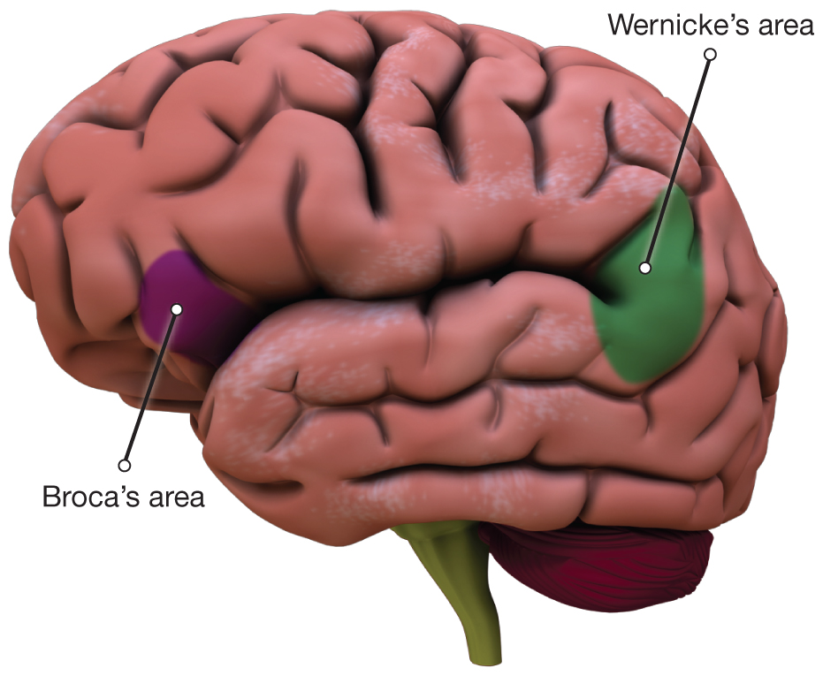
Early Studies of Language
Figure 8.20 Two Language Centres of the Brain
Broca’s and Wernicke’s areas of the cerebral cortex were among the first to be associated with language.
Notes:
1) The most unique and complex aspects of language are based in the left hemisphere (for most) in the regions known as Wernicke’s area and Broca’s area (Module 3.3).
i) Damage to these areas results in aphasias.
Aphasias (p. 316) are language disorders caused by damage to the brain structures that support using and understanding language.
2) Located toward the middle, back portion of the temporal lobe, is Wernicke’s area (Figure 8.20).
Wernicke’s Area (p. 316) the area of the brain most associated with finding the meaning of words.
i) Damage to this area results in Wernicke’s aphasia: a language disorder in which a person has difficulty understand the words he or she hears.
a) This problem involves semantics rather than syntax because the person can talk, but the word choices make no sense.
b) For example, a conversation with someone with Wernicke’s aphasia might look like:
Examiner: Do you like it here in Kansas City?
Person with aphasia: Yes, I am.
Examiner: I’d like to have you tell me something about your problem.
Person with aphasia: Yes, I, ugh, cannot hill all of my way. I cannot talk all of the things I do, and part of the part I can go alright, but I cannot tell from the other people. I usually most of my things. I know what can I talk and know what they are, but I cannot always come back even though I know they should be in, and I know should something eely I should know what I’m doing …
3) Broca’s area appears adjacent to a strip of the brain known as the motor cortex that helps us control body movements (Figure 8.20).
i) This area helps physically produce speech, but also in syntax and processing musical notes.
Broca’s area (p. 316) is a frontal lobe structure that controls our ability to articulate speech sounds that compose words.
ii) A person with damage to this area will most likely be diagnosed with Broca’s aphasia.
a) An individual can still speak, but it is very difficult and consists of limited single words filled with pauses. Even gesturing with speech can be affected.
b) A conversation with someone with Broca’s aphasia might look like:
Examiner: Tell me, what did you do before you retired?
Person with aphasia: Uh, uh, uh, pub, par, partender, no.
Examiner: Carpenter?
Person with aphasia: (Nodding to signal yes) Carpenter, tuh, tuh, twenty year.
iii) Individuals with Broca’s aphasia can understand questions and come up with answers, but just has trouble speaking.
a) He had trouble saying “carpenter” and he missed the morpheme “S” from “twenty year."

Slide 70
Properties of Language
Language (p. 317)
Unique features
Communicate objects and events not in present time and place
Produce new meanings
Passed down naturally to children
Notes:
Language (p. 317) is a form of communication that involves the use of spoken, written, or gestural symbols that are combined in a rule-based form.
1) There are a few basic features of language that make it a unique form of communication.
i) We use it to communicate about objects and events that are not in the present time and place.
ii) We use language to imagine things that are happening on another planet, things that are happening inside of atoms, etc.
iii) We can tell a friend we’re going to order a pizza later tonight and she will not think it’s already there.
a) If we told our dog we were going to give it a treat later tonight, it would here “blar blar blar TREAT blar” and expect a treat right away.
2) Languages can produce entirely new meanings.
i) You alone can produce a sentence that has never been uttered before in the history of humankind.
a) As long as you use English words and grammar, others who know the language should be able to understand it.
ii) In contrast, dog commands and most other animal signals stand alone.
a) Pairing them together does not produce new meanings.
b) Although dogs appear to understand many different words, they do not appear to understand their relationships to other words when put into sentences.
3) Language is also unique because it is passed down naturally from parents to children.
i) Generations of honeybees will do the same dances, but this is more of a biological process (not because elder bees showed them).
ii) Your dog may respond to a number of commands, but it will not train its puppies to sit, stay, or roll over.

Slide 71
Phonemes and Morphemes: The Basic Ingredients of Language
Phonemes (p. 318)
“T”
Morphemes (p. 318)
Pig, ish, or pigish
Productivity
Semantics (p. 318)
Notes:
1) The psychologists’ cooking analogy: We all start with the same basic language ingredients, but they can be mixed together in an unlimited number of ways.
Phonemes (p. 318) are the most basic of units of speech sounds.
2) Individual phonemes typically do not have any meaning by themselves.
i) You cannot tell someone to “T” to get them to stop.
ii) For example, the phoneme associated with the letter T is found at the end of pot or the beginning of stop.
a) Depending on the letters around T, you will have to move your tongue, lips, and vocal cords slightly, which produces different sounds (but still a “T” sound).
b) For example, try saying “stop,” “stash,” “stink,” and “stoke.”
Morphemes (p. 318) are the smallest meaningful units of a language.
3) Morphemes can be simple words, suffixes, or prefixes.
i) The word “pig” is a morpheme; it cannot be broken down into smaller units of meaning.
ii) Morphemes can be combined following the rules of the language.
a) For example, you can describe a person a person as “piggish” by combining the morphemes pig and ish.
iii) Our ability to combine units of sound into an infinite number of meanings (productivity) differentiates language from other forms of communication.
4) Lastly, there are words that make up language.
Semantics (p. 318) is the study of how people come to understand the meaning from words.
i) Humans appear to have a knack for this kind of interpretation.
a) We know tens of thousands of words and can understand the meaning of new words based on their morphemes.

Slide 72
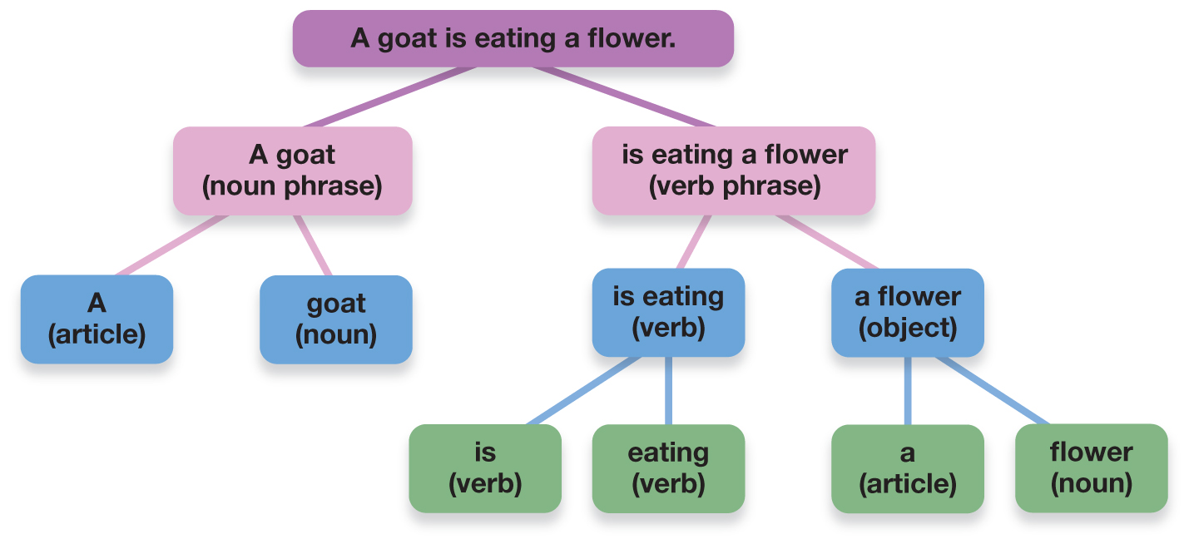
Syntax: The Language Recipe
Figure 8.21 Syntax Allows Us to Understand Language by the Organization of the Words
The rules of syntax help us divide a sentence into noun phrases, verb phrases, and other parts of speech.
Source: Adapted from S. Pinker. (1994). The Language Instinct. New York: HarperCollins.
Notes:
Syntax (p. 319) refers to the rules for combining words and morphemes into meaningful phrases and sentences.
1) Children master the syntax of their native language before they leave elementary school.
i) They can string together morphemes and words.
ii) They can tell the difference between well-formed and ill-formed sentences.
iii) Despite mastering the rules at such an early age, most speakers cannot tell you what the rules are.
2) The most basic units of syntax are nouns and verbs.
i) They are all that is required to construct a well-formed sentence (e.g., “Goats eat.”).
a) However, such sentences are limited, so we build phrases out of nouns and verbs (Figure 8.20).
3) For example, we can change statements into questions by moving specific words.
i) a. A goat is in the garden .
b. IS a goat ______ in the garden ?
ii) However, this does not work in all cases:
a) a. A goat that is eating a flower is in the garden.
b. IS a goat that ______ eating a flower is in the garden?
iii) We must follow a set of rules (syntax) to determine word order.
Long Description:
The figure illustrates the syntax for the sentence “A goat is eating a flower.” The tree-diagram is as follows.
A goat is eating a flower.
a goat (noun phrase)
a (article)
goat (noun)
is eating a flower (verb phrase)
is eating (verb)
is (verb)
eating (verb)
a flower (object)
a (article)
flower (noun)

Slide 73
Pragmatics: The Finishing Touches
Table 8.3 Pragmatic Rules Guiding Language Use
The Rule | Flouting the Rule | The Implication
Say what you believe is true. | My roommate is a giraffe. | He does not really live with a giraffe. Maybe his roommate is very tall?
Say only what is relevant. | Is my blind date good-looking? He’s got a great personality. | She didn’t answer my question. He’s probably not good-looking.
Say only as much as you need to. | I like my lab partner, but he’s no Einstein. | Of course he’s not Einstein. Why is she bothering to tell me this? She probably means that her partner is not very smart.
Notes:
1) Keeping with the cooking analogy, syntax is the recipe for language, whereas pragmatics is the icing on the cake.
i) Syntax takes place in your brain, whereas pragmatics focuses on the speaker’s behaviours and the social situation.
Pragmatics (p. 319) is the study of nonlinguistic elements of language use.
2) Pragmatics is guided by the cooperative principle: pragmatic rules apply to conversation, so entering into a conversation is essentially agreeing to cooperate.
i) For example, the second man in the conversation is not fully cooperating:
A man walks up to another man, who happens to be standing next to a dog. The first man asks, “Sir, does your dog bite?” The second man replies, “No.” But then the dog barks and nips the first man on his fingers. “Ouch! I thought you said your dog does not bite!” the first man complains. To which the second man replies, “I did. But that’s not my dog.”
3) Pragmatics reminds us that sometimes what is said is not as important as how it is said (Table 8.3).
i) For example, your friend did not eat “50 pounds of cheeseburgers,” and you wouldn’t call her a liar for saying it because you know she meant she just ate a lot.

Slide 74
The Development of Language (1 of 2)
Infants, sound perception, and language acquisition
Identifying Sounds
Fast mapping (p. 320)
Notes:
1) In addition to becoming experts at identifying the sounds of their own language,
i) Infants also learn how to separate a string of sounds into meaningful groups (i.e., into words).
ii) Infants as young as two months old show a preference for speech sounds over perceptually similar non-speech sounds (Vouloumanos & Werker, 2004).
iii) When presented with pronounceable non-words (e.g., strak), infants prefer to hear words that follow the rules of their language.
2) Young children rapidly learn new words.
Fast mapping (p. 320): the ability to map words onto concepts or objects after only a single exposure.
i) Naming explosion: a rapid increase in vocabulary size that occurs at this stage of development.

Slide 75
The Development of Language (2 of 2)
Table 8.4 Milestones in Language Acquisition and Speech
Average Time of Onset (Months) | Milestone | Example
1–2 | Cooing | Ahhh, ai-ai-ai
4–10 | Babbling (consonants start) | Ab-ah-da-ba
8–16 | Single-word stage | Up, mama, papa
24 | Two-word stage | Go potty
24+ | Complete, meaningful phrases strung together | I want to talk to Grandpa.
Notes:
3) Producing spoken language (Table 8.4): Early psychologists believed that language was learned through imitating sounds and being reinforced for pronouncing and using words correctly. However, learning through imitation and reinforcement is only one component of language development.
i) Children often produce phrases that include incorrect grammar or word forms. Because adults do not (often) use these phrases, it is highly unlikely that such phrases are imitations.
ii) Children learn irregular verbs and pluralizations on a word-by-word basis. At first, they will use “ran” and “geese” correctly. However, when children begin to use grammar on their own, they over-generalize the rules. It is also unlikely that children would produce these forms by imitating.
iii) When children use poor grammar, or when they over-generalize their rules, parents may try to correct them. Although children will acknowledge their parents’ attempts at instruction, this method does not seem to work. Instead, children go right back to over-generalizing.

Slide 76
Sensitive Periods for Language
Sensitive period
Brains are primed to develop language skills
Ability fades starting seventh year
Same with sign language
Notes:
1) Most psychologists believe children pick up language so much easier than adults because there is a sensitive period for language.
i) This is a time during childhood in which children’s brains are primed to develop language skills.
a) Children can absorb language almost effortlessly, but this ability fades starting the seventh year.
b) Children who receive cochlear implants before the age of two develop speech better than those who receive implants after age four.
ii) Cross-cultural research shows that sign language also has a sensitive period.
a) Children can pick up sign language rather quickly, whereas deaf adults who learn to sign later in life will never be as fluent.

Slide 77
The Bilingual Brain
Costs
Smaller vocabulary
Word access
Benefits
Executive functions
Health benefits
Notes:
1) There are some costs to bilingualism:
i) Bilingual children tend to have a smaller vocabulary in each language than unilingual children.
ii) In adulthood, this difference is shown not by vocabulary size, but by how easily bilinguals can access words. Compared to unilingual adults, bilingual adults are slower at naming pictures, have more difficulty on tests that ask them to list words starting with a particular letter, have more tip-of-the-tongue experiences in which they can't quite retrieve a word, and are slower and less accurate when making word/non-word judgments. These problems with accessing words may be due to the fact that they use each language less than a unilingual person would use their single language.
2) The benefits of bilingualism, however, appear to far outweigh the costs.
i) One difference that has been repeatedly observed is that bilingual individuals are much better than their unilingual counterparts on executive functions. These enable people who speak more than one language to inhibit one language while speaking and listening to another (or to limit the interference across languages).
ii) Bilingualism has also recently been shown to have important health benefits (reduce risk of dementia).

Slide 78
Working the Scientific Literacy Model: Genes and Language (1 of 4)
What do we know about genes and language?
Language evolved to solve problems
Number of genes involved
Which scientific evidence supports a genetic basis of language?
FOXP2 gene
Notes:
1) What do we know about genes and language?
i) Many scientists believe the evidence is overwhelming that language is a unique feature of the human species that evolved to solve problems related to survival and reproduction.
ii) Language adds greater efficiency to thought, allows transmission of information without requiring direct experience (with potential dangers), and facilitates social needs and desires.
iii) As with most complex behaviours, there are likely a number of genes involved with language.
a) However, there appears to be one gene of particular importance.
2) Which scientific evidence supports a genetic basis of language?
i) All humans carry the gene FOXP2.
a) The physical and chemical processes of this gene codes for are related to language.

Slide 79
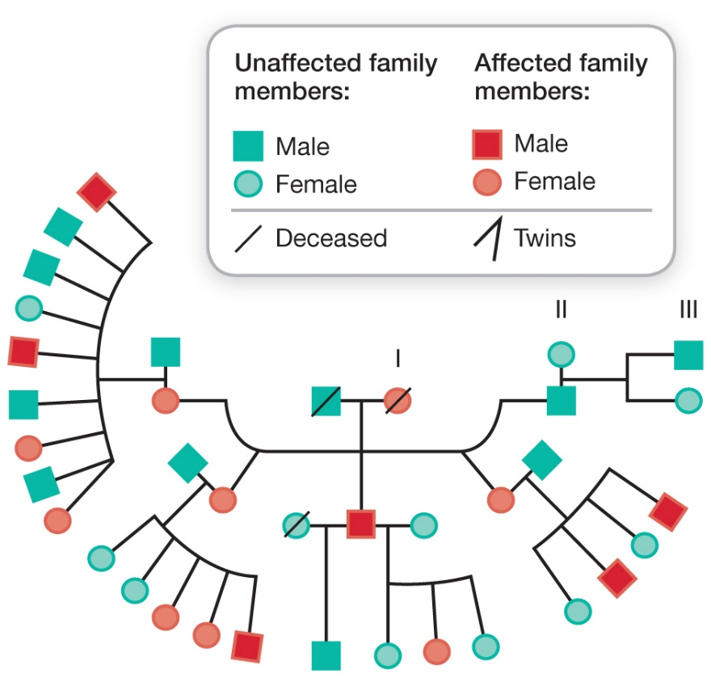
Working the Scientific Literacy Model: Genes and Language (2 of 4)
Figure 8.22 Inheritance Pattern for the Mutated FOXP2 Gene in the KE Family
Family members who are “affected” have inherited a mutated form of the FOXP2 gene, which results in difficulty with articulating words. As you can see from the centre of the figure, the mutated gene is traced to a female family member and has been passed on to the individuals of the next two generations.
Source: Republished with permission of Nature Publishing Group, from Vargha-Khadem, F., Gadian, D. G., Copp, A., & Mishkin, M. (2005). FOXP2 and the neuroanatomy of speech and language, Fig. 1, Nature Reviews Neuroscience, 6, 131–138. Copyright 2005; permission conveyed through Copyright Clearance Center, Inc.
Notes:
1) The KE family has a mutated copy of this gene, so those in this family have great difficulty putting thoughts into words (Figure 8.22).
a) They have no problems performing tasks, so they are still able to think.
iii) Brain scans were taken of KE family members who inherited the mutated gene and those who did not (Figure 8.23).
a) They were asked to generate words themselves and to repeat the words back to experimenters.
b) Those with a normal gene showed typical activity in the Broca’s area in the left hemisphere.
c) Those with the mutated gene had no activity in Broca’s area, that the activity in the brain was unusual for that type of task.
Long Description:
The figure is colour-coded and shows three generations of the family. A key explains the colour coding as “Male”, “Female”, “Affected family member”, “Unaffected family member”, “Deceased”, and “Twins.” The figure, starting with the first generation, is as follows.
First generation: Deceased unaffected male, Deceased affected female
The first generation has 5 children – 3 affected females, 1 affected male, and 1 unaffected female.
The affected male has 2 spouses, one of them is deceased. Their children and their spouses are as follows.
Affected female; Unaffected male (spouse)
Affected male: 2
Unaffected male: 4
Affected female: 2
Unaffected female: 1
Affected female; Unaffected male (spouse)
Affected male: 1
Unaffected male: 0
Affected female: 2
Unaffected female: 2
Affected male with Deceased unaffected female (spouse)
Affected male: 0
Unaffected male: 1
Affected female: 0
Unaffected female: 0
Unaffected female (spouse)
Affected male: 0
Unaffected male: 0
Affected female: 1
Unaffected female: 2
Affected female; Unaffected male (spouse)
Affected male: 0
Unaffected male: 2
Affected female: 0
Unaffected female: 2
Un affected male; Unaffected female (spouse)
Affected male: 0
Unaffected male: 1
Affected female: 0
Unaffected female: 1

Slide 80
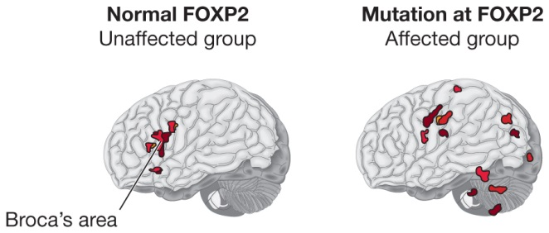
Working the Scientific Literacy Model: Genes and Language (3 of 4)
Figure 8.23 Brain Scans Taken While Members of the KE Family Completed a Speech Task
The unaffected group shows a normal pattern of activity in Broca’s area, while the affected group shows an unusual pattern.
Source: Figure 1 republished with permission of Nature Publishing Group: Liégeois F., Baldeweg T., Connelly A., Gadian D. G., Mishkin M., Vargha-Khadem F. (2003). Language fMRI abnormalities associated with FOXP2 gene mutation. Nature Neuroscience, 6(11), 1230–1237. Permission conveyed through Copyright Clearance Center, Inc.
Notes:
1) The KE family has a mutated copy of this gene, so those in this family have great difficulty putting thoughts into words (Figure 8.22).
a) They have no problems performing tasks, so they are still able to think.
iii) Brain scans were taken of KE family members who inherited the mutated gene and those who did not (Figure 8.23).
a) They were asked to generate words themselves and to repeat the words back to experimenters.
b) Those with a normal gene showed typical activity in the Broca’s area in the left hemisphere.
c) Those with the mutated gene had no activity in Broca’s area, that the activity in the brain was unusual for that type of task.
Long Description:
The figure shows that the unaffected group have normal “FOXP2” and the affected group have mutation at “FOXP2.” The figure shows the left and right images of each of the scans.
Unaffected group
The left image shows red dots at the “Broca’s” area. The right image does not show any dots.
Affected group
The left image shows small red dots at random places of the brain and not at the “Broca’s” area. The right image shows more red dots than in the left image. The dots are spread over many regions of the brain.

Slide 81
Working the Scientific Literacy Model: Genes and Language (4 of 4)
Can we critically evaluate this evidence?
Many genes work together
FOXP2 not unique to humans
Language is unique to humans
Why is this relevant?
Links between genes and language
Notes:
1) Can we critically evaluate this evidence?
i) There are almost certainly a large number of genes working together to produce each component of language. Other genes will need to be identified; FOXP2 is just the beginning.
ii) Although studies such as these show the importance of the FOXP2 gene in language, it is not unique to humans (like language is).
a) Mice have a version very similar in molecular structure.
b) The molecular structure and activity of the FOXP2 gene in songbirds (unlike-non-songbirds) is similar to that in humans.
2) Why is this relevant?
i) This research helps us to further understand the links between genes and language.
ii) Someday, other individuals genes will be found that have direct links to language function.

Slide 82
Can Animals Use Language?
Chimpanzee Viki
Cross-fostered (p. 324)
Four words
Chimpanzee Washoe
ASL
200 signs
Generalized words
Bonobo Kanzi
Lexigrams
350 symbols
3,000 spoken words
Notes:
1) Formal studies of language learning in nonhuman species gained momentum in the mid-1950s when psychologists attempted to teach spoken English to a chimpanzee named Viki.
i) Viki was cross-fostered by humans.
ii) However, after many years of trying, she was only able to whisper about four words.
Cross-fostered (p. 324): raised as a member of a family that was not of the same species.
2) In the 1960s, researchers attempted to teach chimpanzees American Sign Language (ASL).
i) It was thought that the lack of language in Viki’s case was not due to brain ability, but limitations in the vocal tract and tongue.
ii) The first chimpanzee, Washoe, was immersed in an environment rich with ASL, with everyone signing instead of speaking.
a) By two years old, Washoe acquired 35 signs through imitation and direct guidance of how to move her hands.
b) Eventually, she learned around 200 signs.
c) She was also able to generalize signs from one context to another. For example, she learned the word “open” using certain doors and cupboards and later signed open for other doors, cupboards, as well as her soda bottle.
3) Researchers taught a bonobo named Kanzi an artificial language using symbols that represented complex ideas and phrases (lexigrams).
i) He learned about 350 symbols through training.
ii) However, he learned his first symbols by watching researchers attempting to teach his mother how to use the language.
iii) He also seems to recognize about 3,000 spoken words.
iv) His trainers believe his skills constitute language.
a) He can understand symbols and at least some syntax.
b) He acquired symbols simply be being around others who use them.
c) He produced symbols without specific training or reinforcement.
4) Although these animals appear to be able to communicate effectively, debate continues about whether these animals are using language.
i) Researchers working with language-trained apes point out some key differences between species:
a) Apes communicate with only symbols, not with the phrase-based syntax used by humans.
b) There is little evidence showing that apes pass their language skills to other apes.
c) Productivity—creating new words (gestures) and using existing gestures to name new objects or events—is rare, it is occurs at all.
d) Some of the researchers become very engaged in the lives of the animals and talk about them as friends and family, which may interfere with the objectivity of the data.

